Slide 1
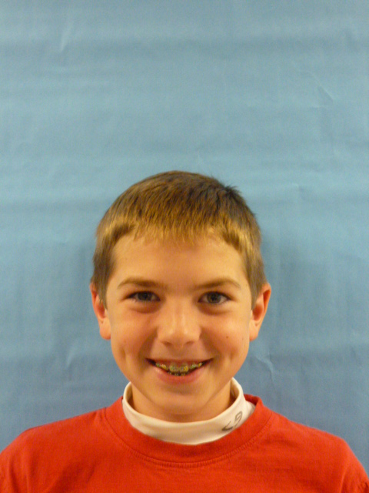

Slide 2
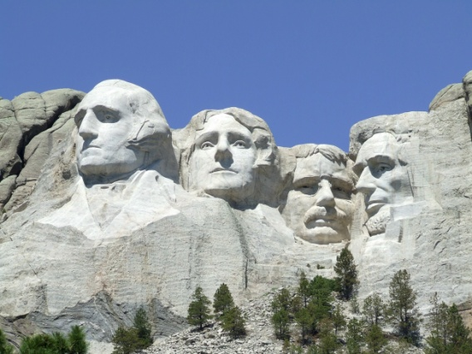
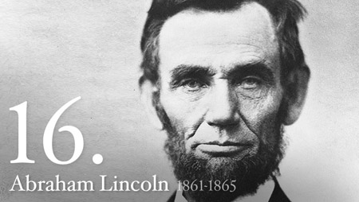
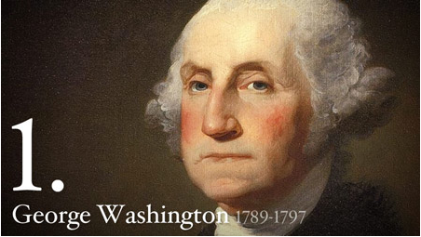
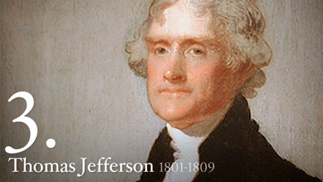
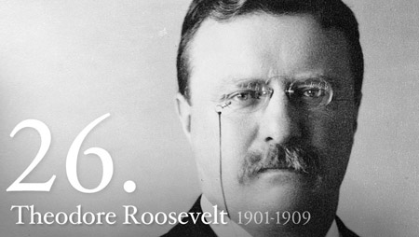
Greetings I’d like to thank all the people who voted for me. Well I have a lot of ideas the next 4 years. I’ll try to make all the people of the (U.S.A) United States of America very thankful and happy to be in America.

Slide 3
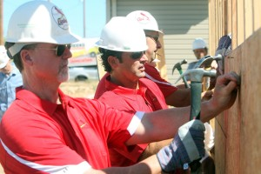
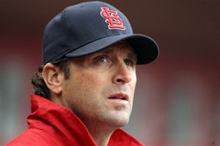
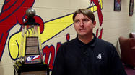
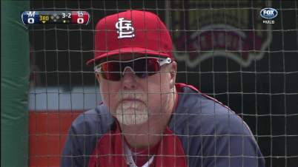
There are people from countries that are homeless. For example the Joplin tornado was a downer for all people In Joplin. The St Louis and Springfield Cardinals helped build houses and helped a lot of people. Now we want the whole world to help out

Slide 4
Think of all the people out there who have cancer we need to help them. So we could have people from all around the United States of America to send something to all the adults and kids who have cancer. I hope around October to see that you care by wearing a pink ribbon for all those who have cancer.

Slide 5
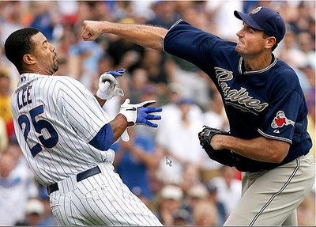
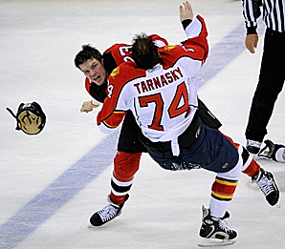
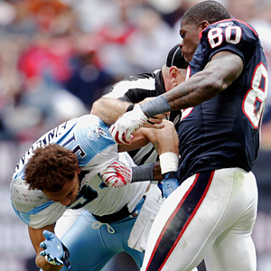
All the sports we play are fun. But there are people that get hurt in Baseball, Hockey, Football, and a bunch of other sports. The best player of the NHL Wayne Gretzky says fighting needs to stop but I bet we can make fighting easier.
Go Cardinals

Slide 6
Thank you for listening to my suggestions. That’s all I have for today. But it’s not over I’ll be making suggestions for the next 4 years! Thank you again for voting me for president.

