Slide 1
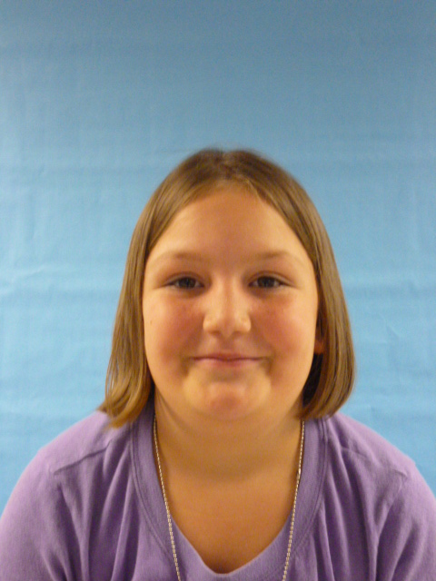
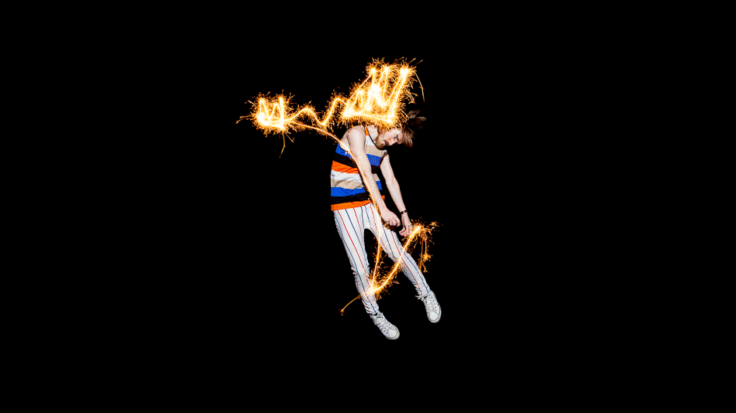
I'm Happy To Be Your President
I love the USA

Slide 2
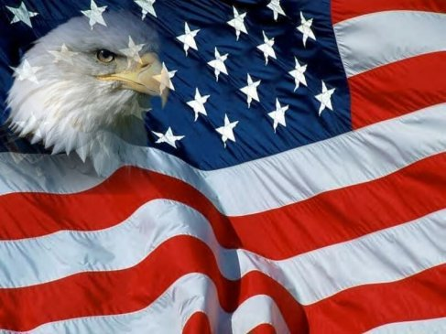
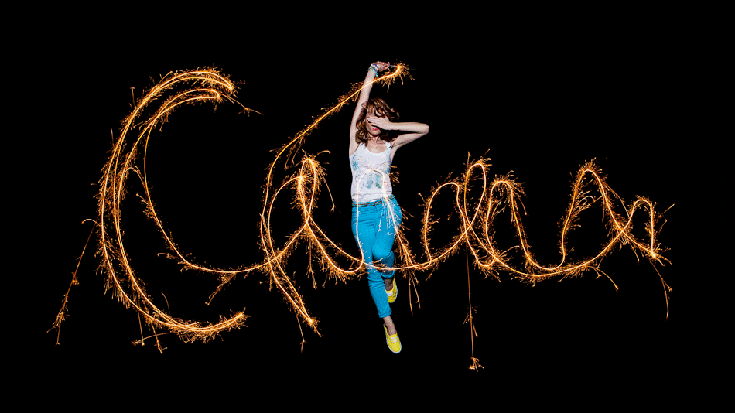
I am thankful to be the President because I can give more days and more homework and on Sunday we can have more school and Saturday.

Slide 3
I can give out more candies to the kids and family too.

Slide 4
In school they can set anywhere they won’t to set at school.

Slide 5
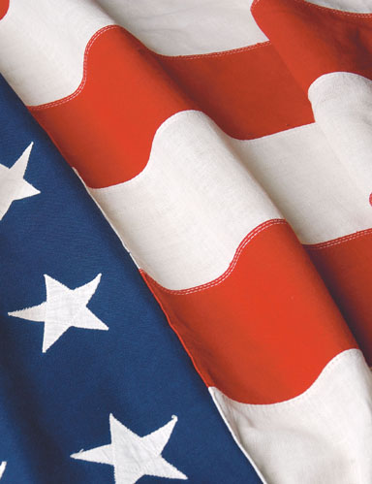
There were not be any recess and more math and more snacks.

