Slide 1


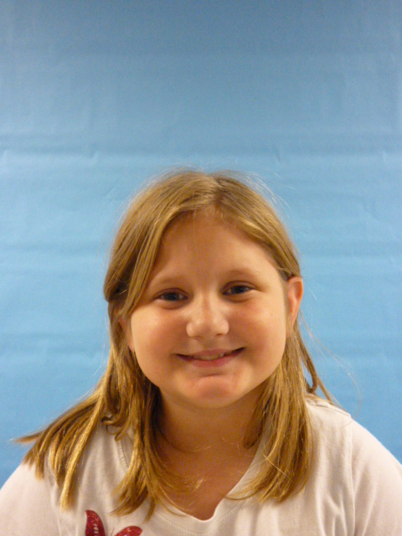
USA
President

Slide 2

Hi I am the new President.

Slide 3
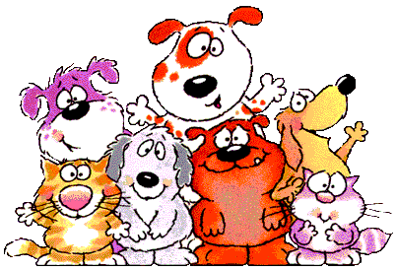
I am going to put more public things like animal shelters.

Slide 4
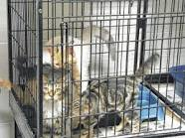
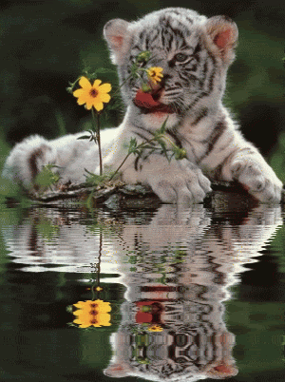
Because people there might not have rooms and it is too full.

Slide 5
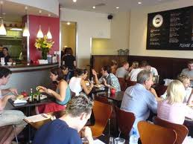
I am going to put more restaurants.

Slide 6
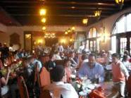
Because it might be packed.

Slide 7

That is all for today, so good bye!

