Slide 1
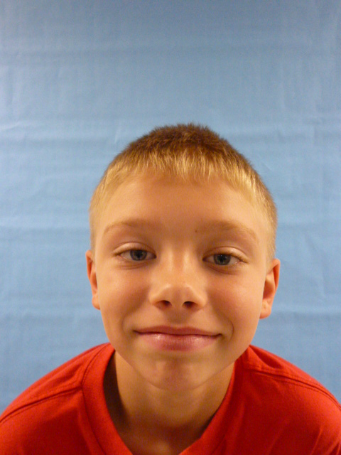

Slide 2
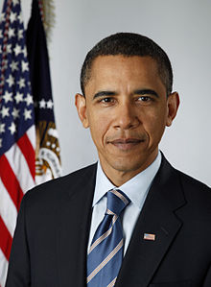
I want to be your President. I’m honest. I’m a good listener and trustworthy.

Slide 3
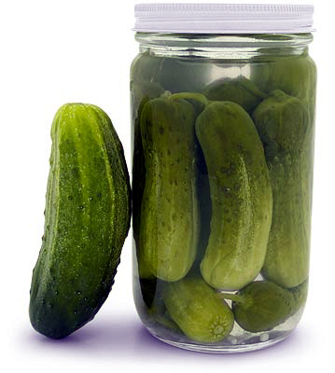
I’ll give food to the poor.

Slide 4
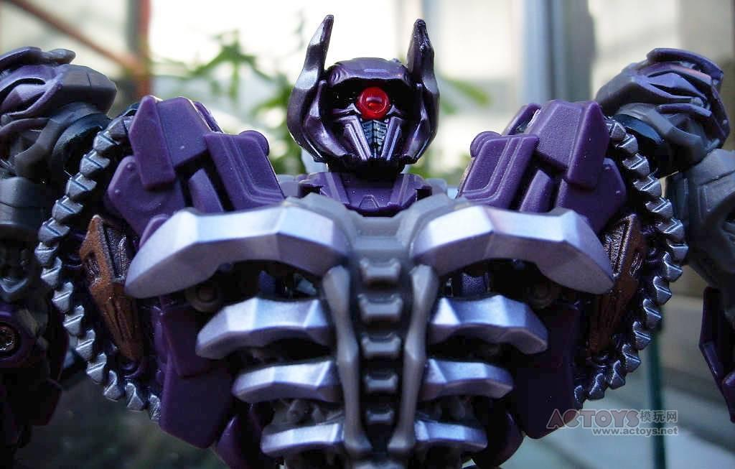
I’ll give toys to the kids that do not have toys.

Slide 5
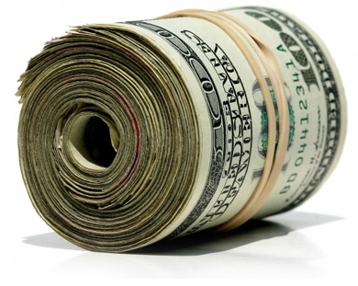
I will give money to poor people

Slide 6
I like being your president.

