Slide 1
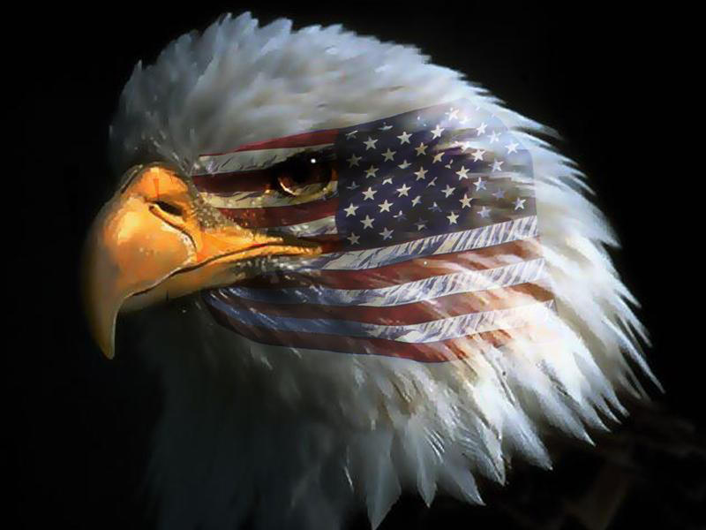
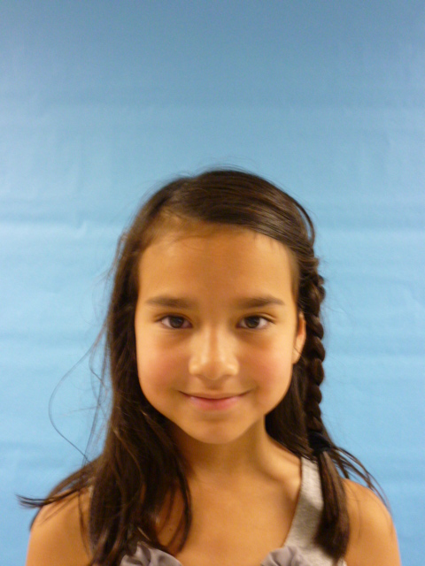
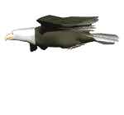
USA

Slide 2
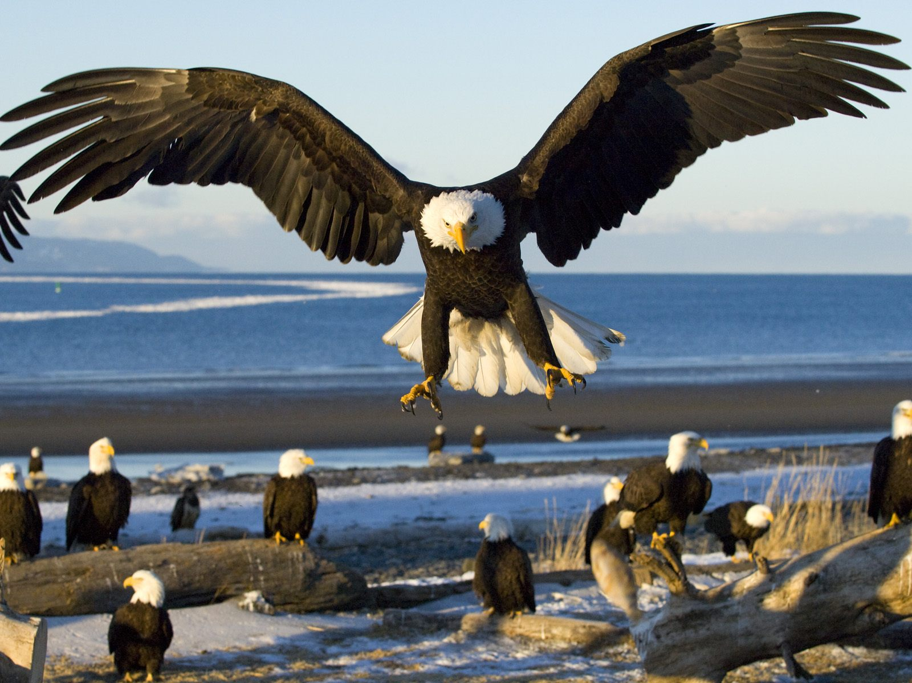
Hello everybody am your new President so I’m going to tell you a few things I love to help people and I hope you like me as your new President I am so happy to be here right now and I’m going to make the United States a better place for each and every one of you hopefully you like my speech.

Slide 3
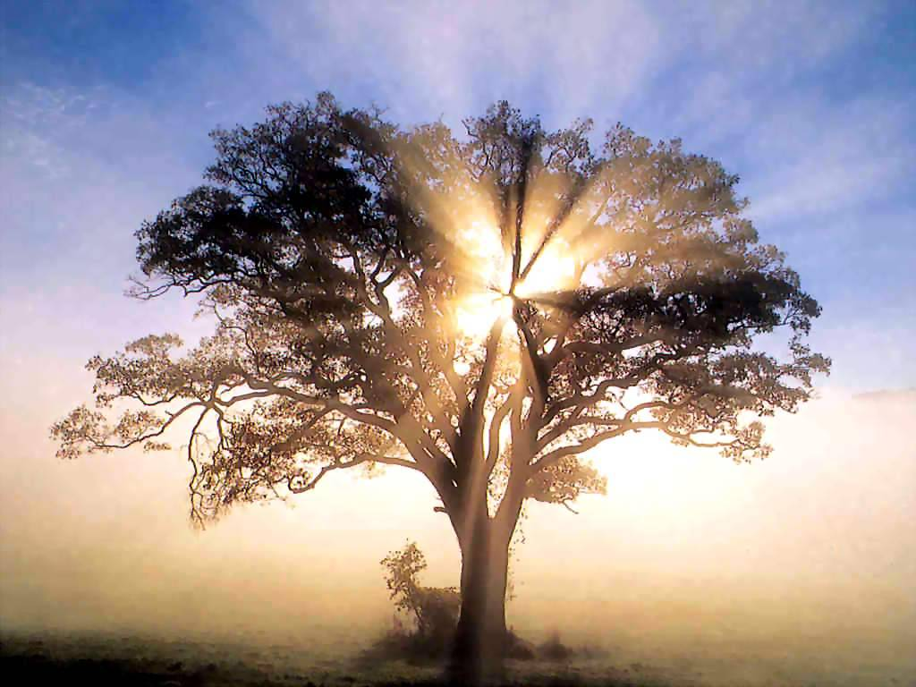
I would make people stop cutting down homes for animals like: owls, squirrels, birds and bats by making signs saying NO TREE CUTTING in that place or consequences!!!

Slide 4
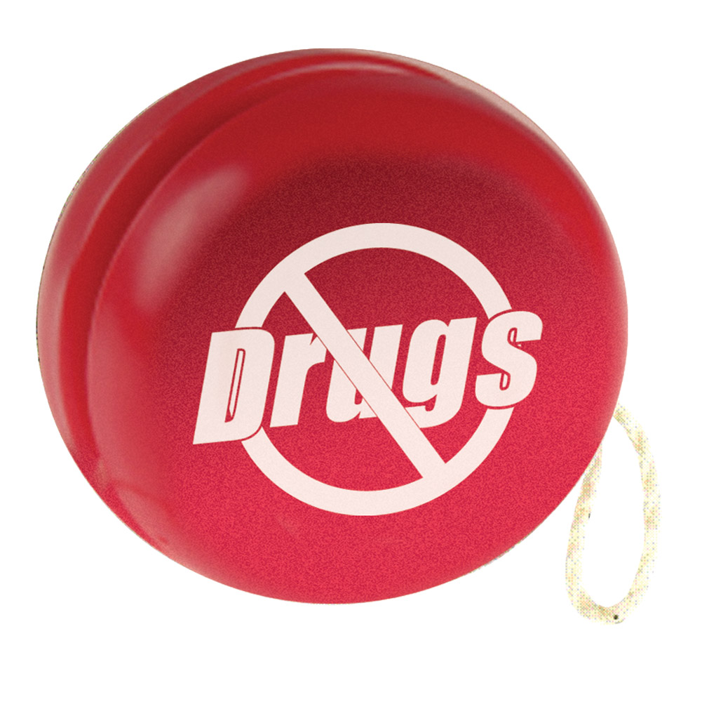
I would make people stop doing drugs by trying to tell them that it could kill you and you should stop at that because if you are you WILL have to stop or bad things will happen……….

Slide 5
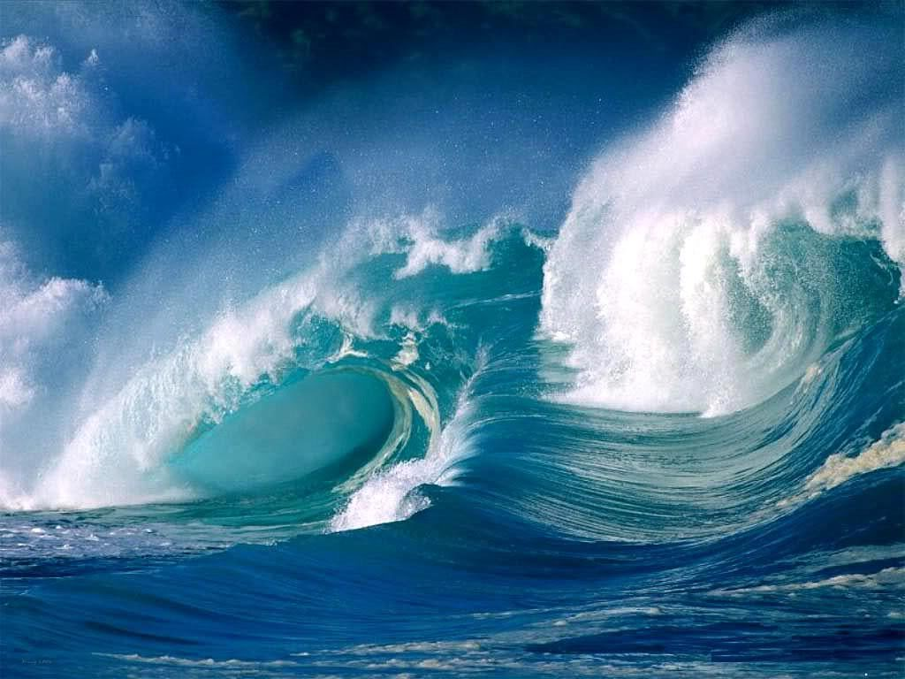
People need to STOP TRASHING the ocean this instant!! Sea creatures are dying from trash in the water. The Seagull beaks are getting caught in trash that people throw in the water or sand and the water can get dirty from trash floating and ruining homes for those sea creatures. If you still throw trash then oohh……..you will not like what’s going happen to you.

Slide 6
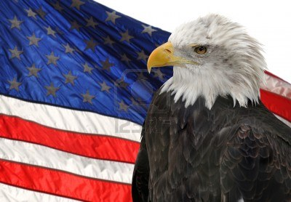
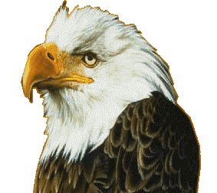
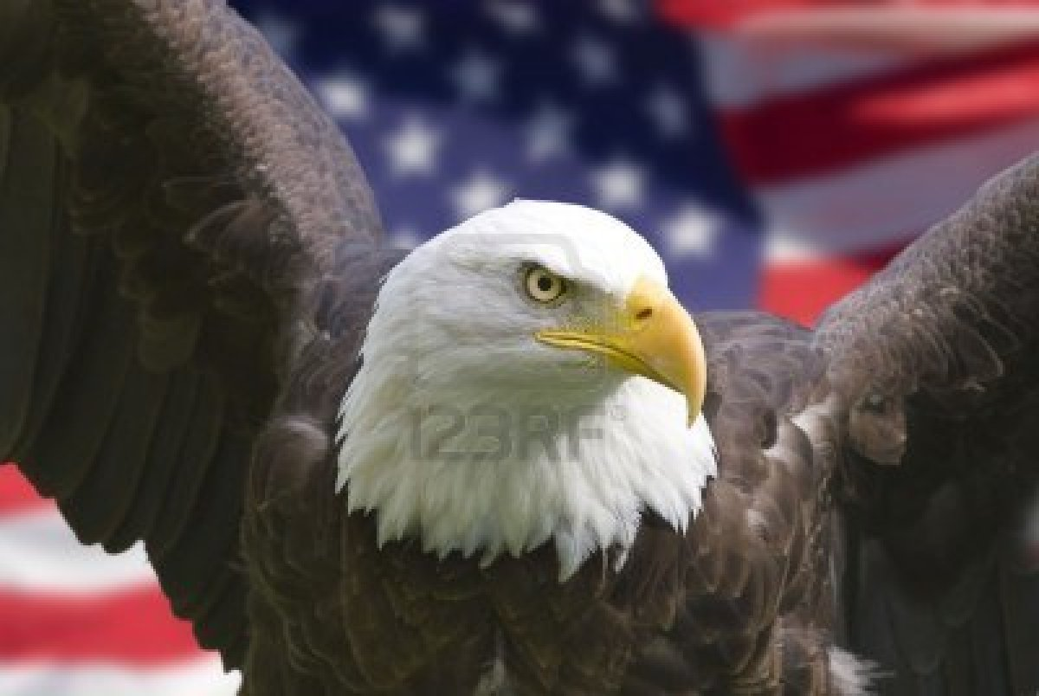
Well that’s all I have to say thanks for listening and please FOLLOW THESE RULES!!! Bye!

