Slide 1
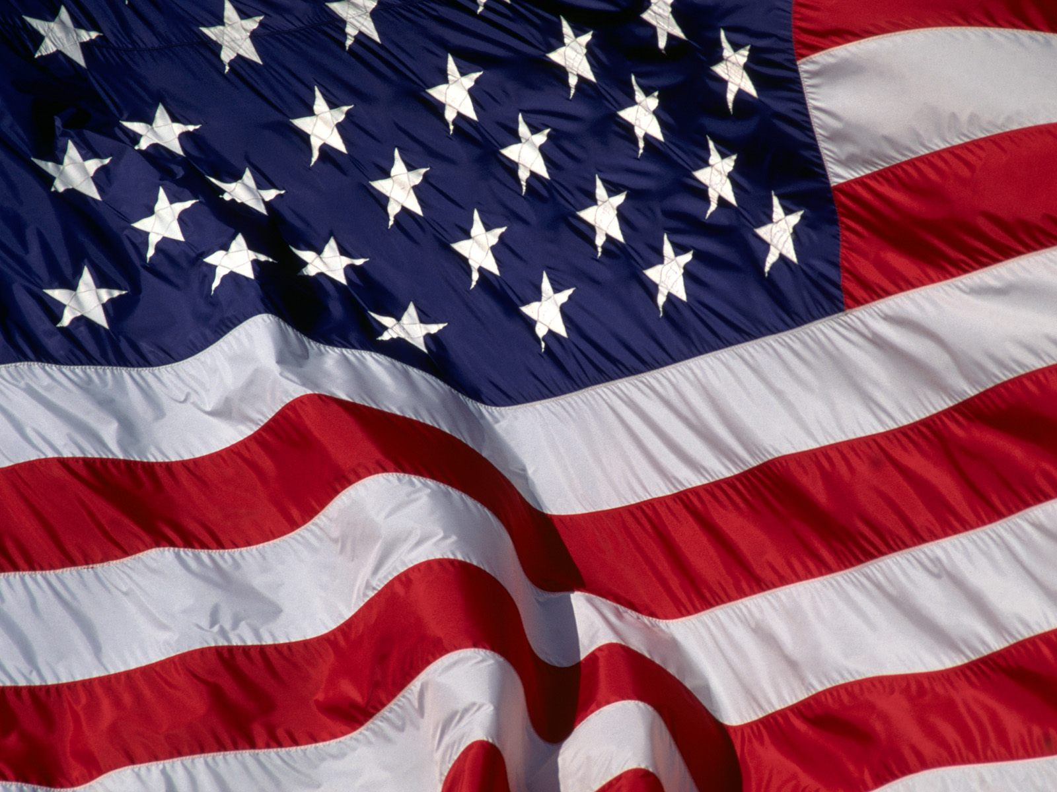
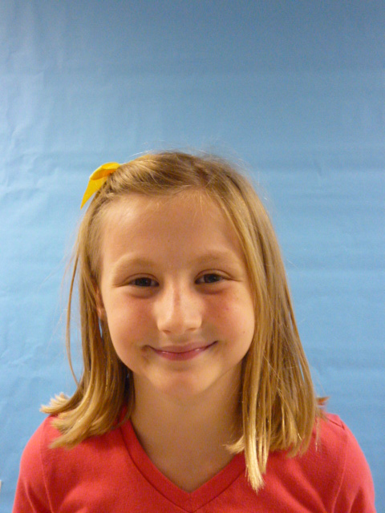
U.S.A.

Slide 2
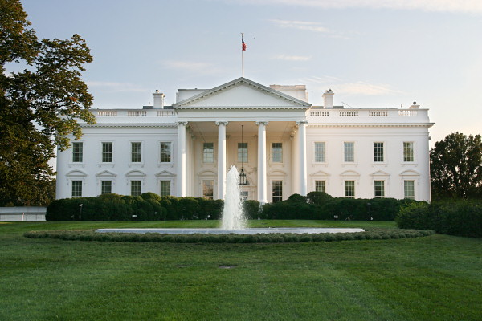


I am President I love living in the White House. The things I would do to help this country are…

Slide 3
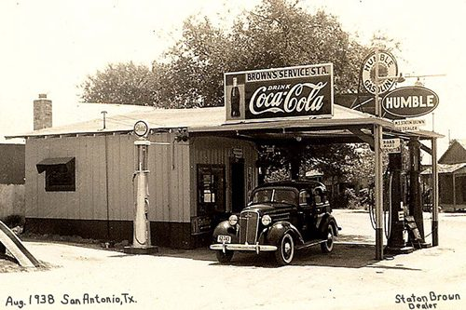
lower gas prices; they are way too high; I would tell all the gas stations that they would still get the profits they get now.

Slide 4
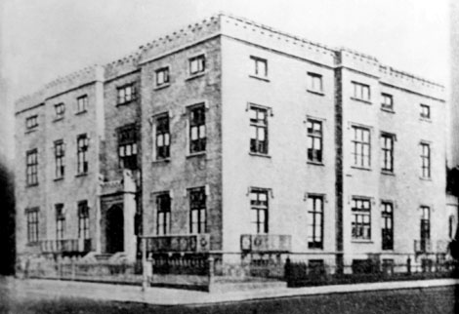
I am making sure that each school gets at least 1 recess each day , I would have a big conference with all the teachers and tell them kids need fresh air it is good for their brains. Teachers need brakes too.

Slide 5
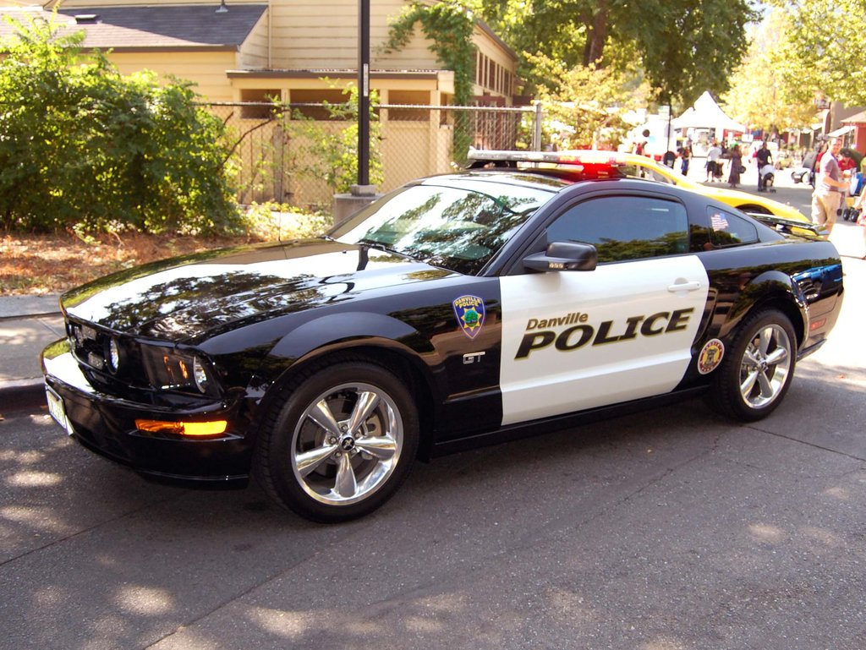
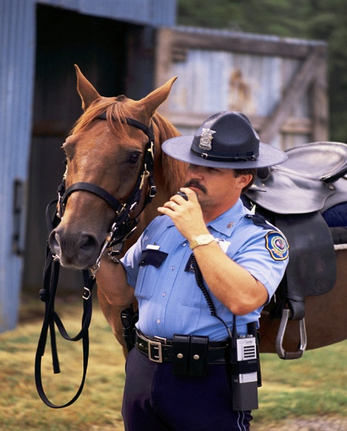
I would make sure there is not as much violence there is today; to do that I would get more polices guards’

Slide 6

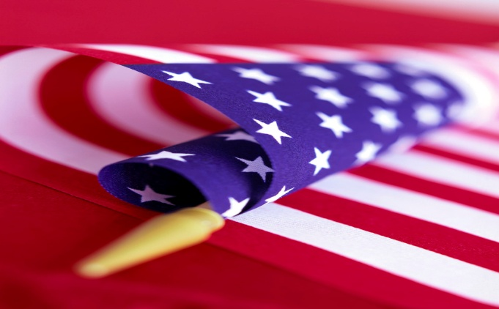
The U.S.A. would be a lot safer place to live since I am the President P.S. MY FAVORIT COLORS ARE RED, WHITE AND BLUE!

