Slide 1
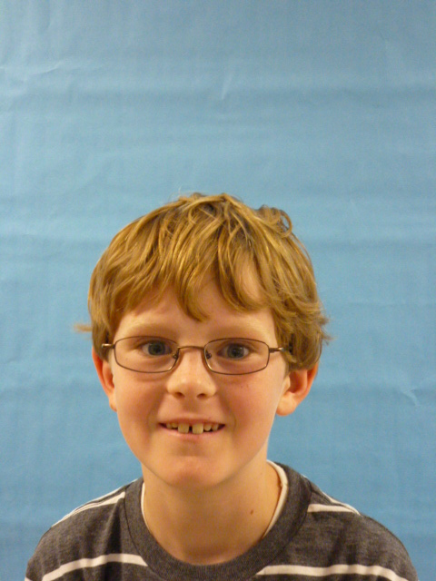
U.S.A

Slide 2
Hello I am excited to be President of the United States of America.

Slide 3
You need to stop smoking it is a bad habit to get in to it can get you hurt. Another reason to stop smoking is because it can harm your health.

Slide 4
I want to make more health markets and lower prices so people do not have to spend a lot of money to give to the sick people and also just to get medicine.

Slide 5
I want all of the people to have homes so they can have a shelter.
All the people should get a home so they can stay safe. People should get a home so they can also have a safe place to be in a storm. Houses are very important!

Slide 6
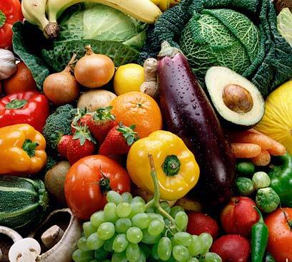
Staying healthy is also important to I want all the people to buy at least five fruits and vegetables. Fruits and vegetables are very important. I want every food store in America to have lots of fruits and vegetables to keep people healthy.

Slide 7
I am super excited to be your President.

