Slide 1


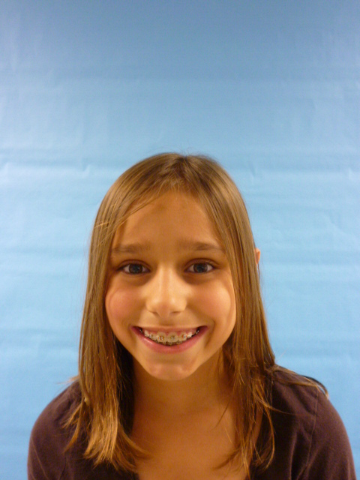


Slide 2

Hi I am the President and I want talk about me I like to draw and do gymnastics. I really like being a president. I like to be on TV when I do my speeches.

Slide 3
I would make schools have more recess. Why I would do this is so that kids can learn to interact with others. And you need exercise every day.

Slide 4
I would make a rule that you could NOT have a big animal for a pet. Like an elephant or a giraffe. If you do have a big pet like that your house will be trampled down to the ground.

Slide 5

I would not let there be smoking in buildings.
How I would do that is to not let all stores sell lighters. I would put up bill boards to tell you not to smoke.

Slide 6
I LOVE being your President. I hope you like my plans. I will have fun for my 4 years of being the President.

