Slide 1
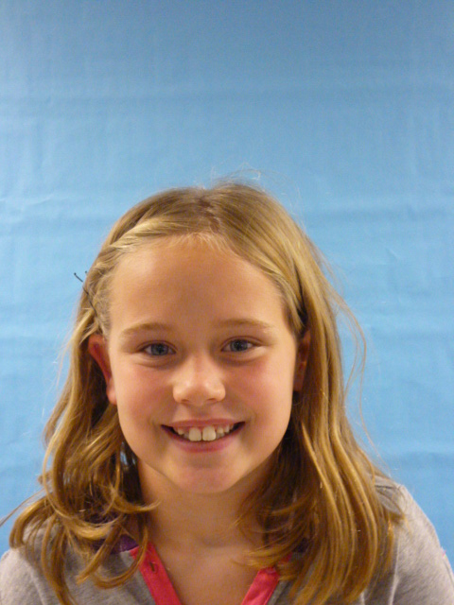
USA
YOU
ROCK

Slide 2
I am a love bull person. I like to play a lot. I am a really tall person.
I like to do homework at home.

Slide 3
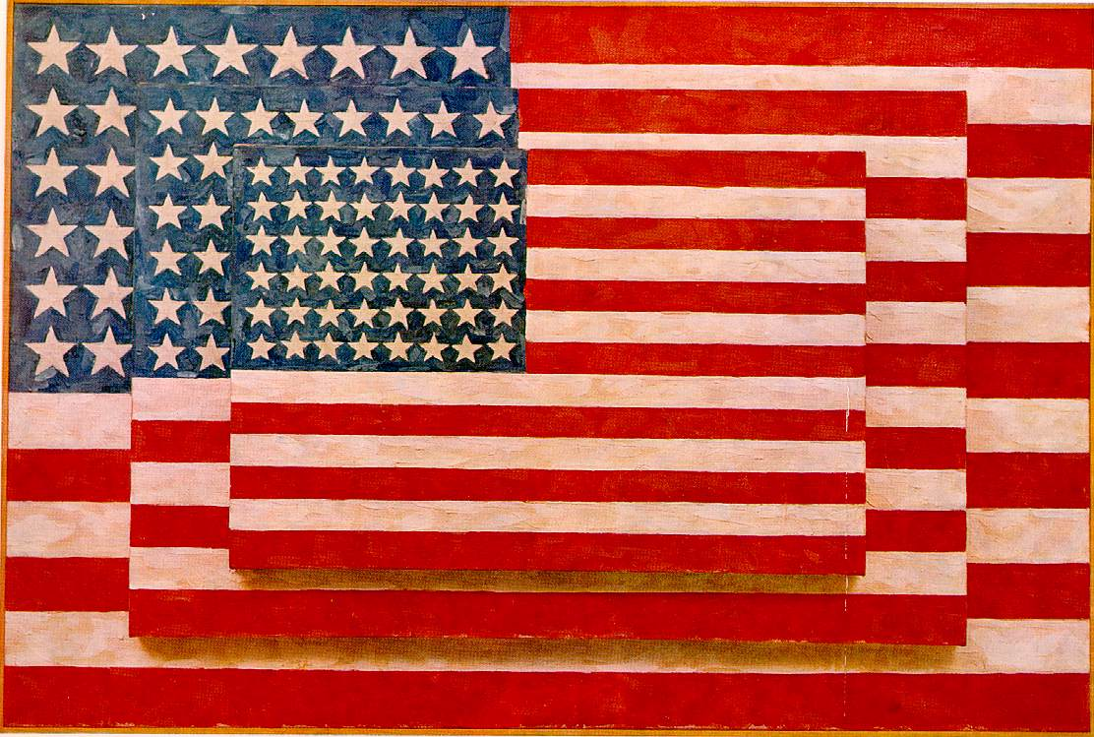
I think that there shod be no drugs because it will make the community a better place. Please do not make things die like plans and other things.

Slide 4
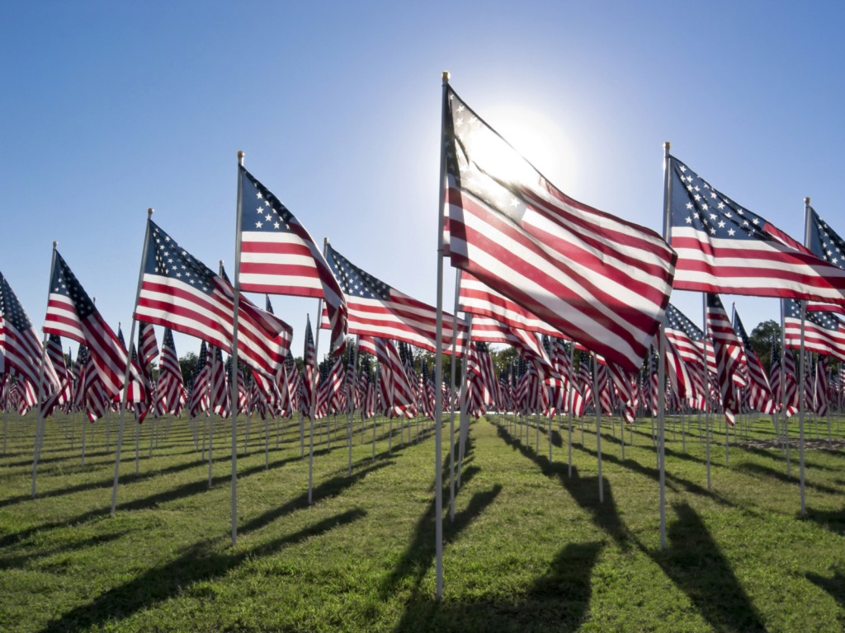
I will not let people brake down and so I will make the gas prices to $o and 0 sins !!

Slide 5
I will not let people smoke because it is bad for people. PLEASE do not please with surge on top.

Slide 6
That is all I want to talk about . thanks for voting for me. Bye!!!!!!!!

