Slide 1

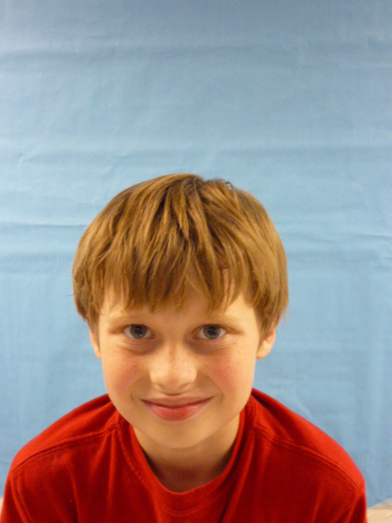
PRESIDENT OF THE USA

Slide 2

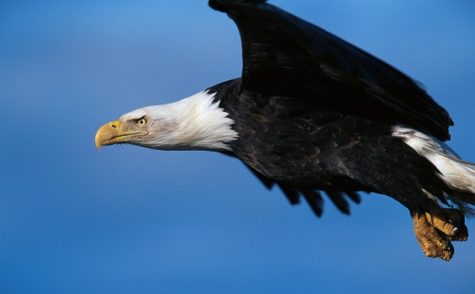
Hi these are the things that I would do in my presidency.

Slide 3
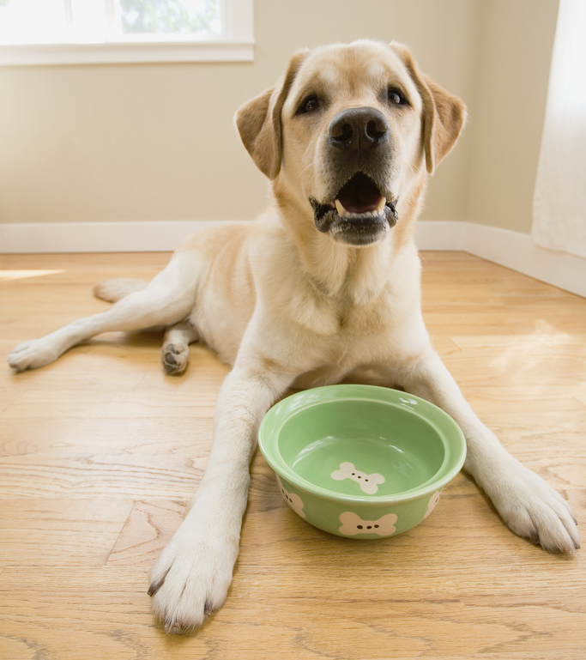
I will not let people abuse there dog. Or any animal.

Slide 4
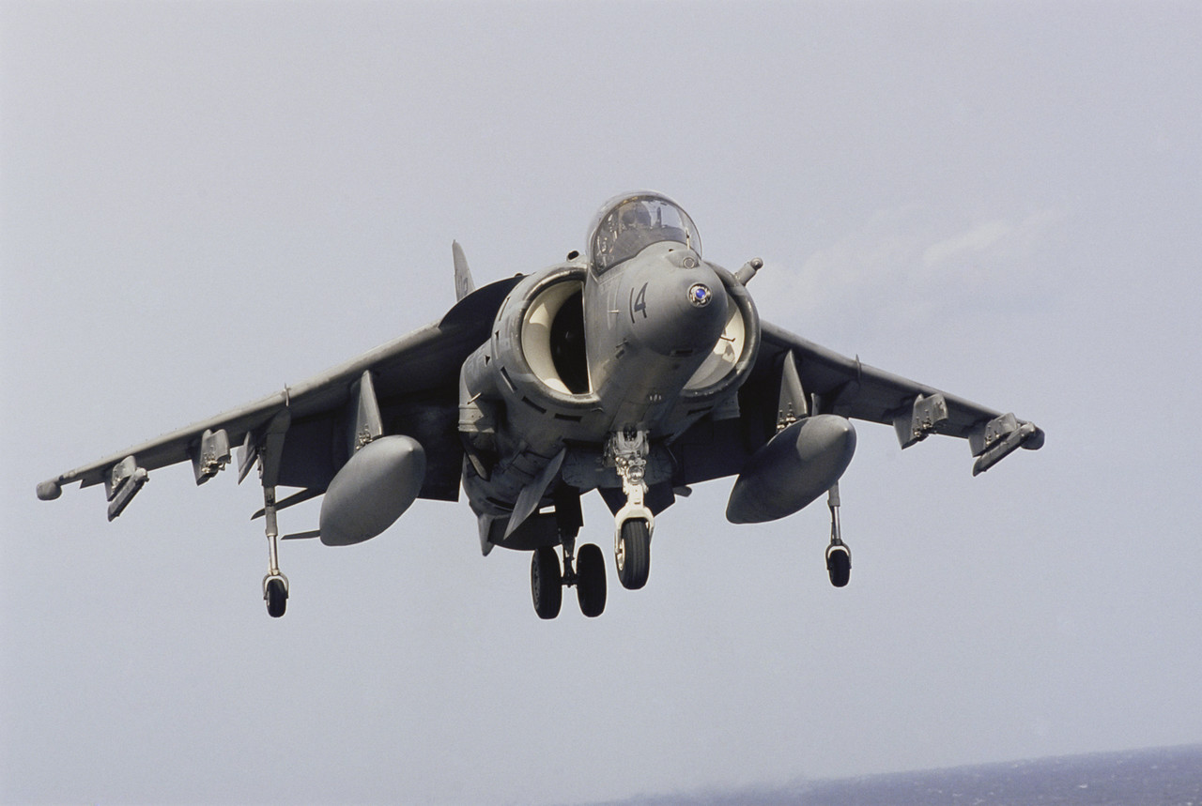
I will give more defenses to the military . To protect us.

Slide 5
I will give children more time to exercise. More specials to.

Slide 6

I will give more equipment to the police. To catch people who abuse the law .

