Slide 1
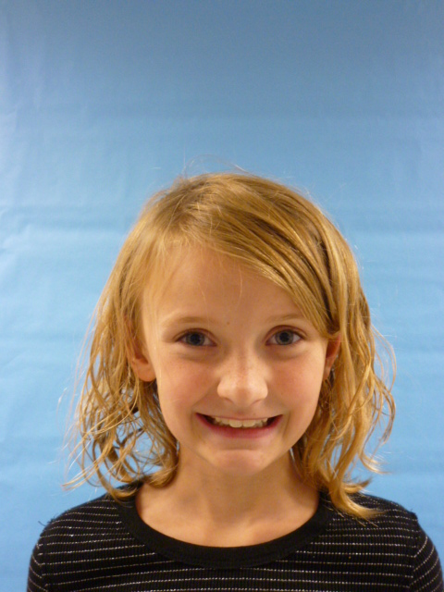
President of the USA
USA
1

Slide 2
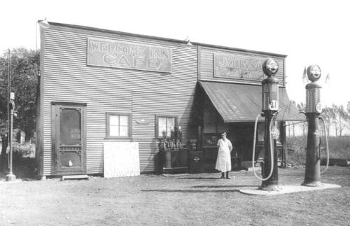
I am President of the United States of America. I will lower gas prices. Because it is too much money. And I will talk to the people that work their!

Slide 3
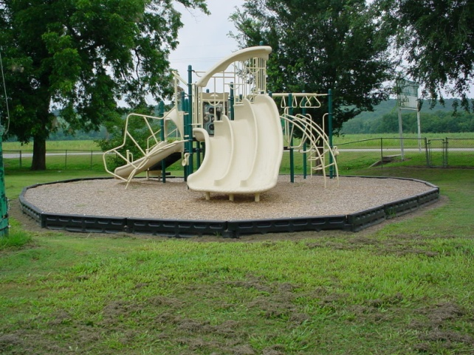
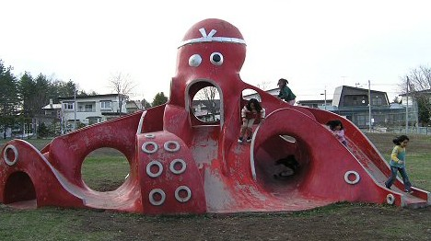
I think kids need more Recess. Because kids think too hard. I would talk to the teachers about it.

Slide 4
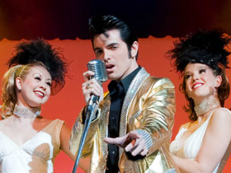
I think they should let the people in concerts free! Because some people are poor. I would talk to the concert people about it!

Slide 5
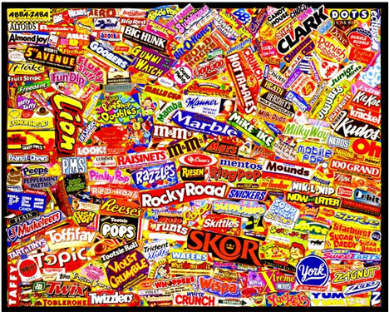
I think kids need more candy at school. Because we just need more candy. I would hang up sings on schools.

Slide 6
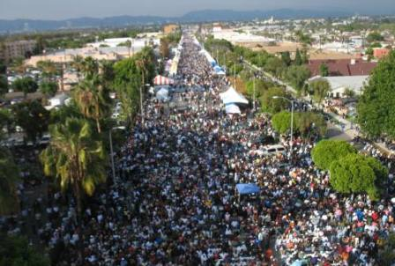
I would make sure everybody follows my laws. If not somebody would get hurt. I would put up sings everywhere

