Slide 1
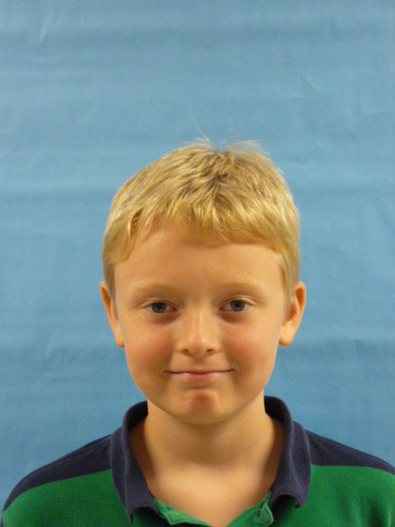

Slide 2
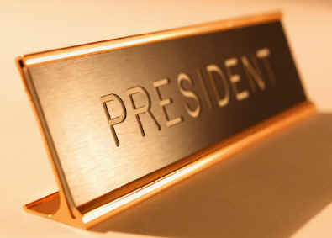
Thank you for electing me so I am the President of the United States of America. I may not be the greatest president but I am here. I will lower gas prices everywhere in the U.S. I will stop all the wars in my term.

Slide 3
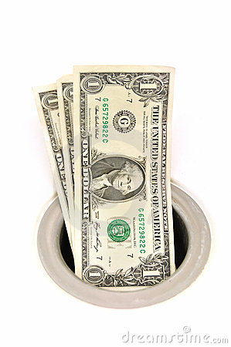
I will make new laws such as NO smoking in public areas. Because YOU can get lung cancer. I am very smart. I will lower taxes to $18.

Slide 4
In this economy prices are terrible! I will fix it. I will make everything cheaper

Slide 5
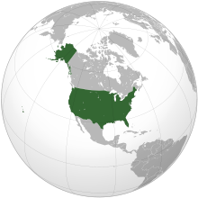
I will invest in education.
I will make America a better place.

Slide 6
Once again thank you for electing me. I will make this the BEST 4 years of your life.

