Slide 1
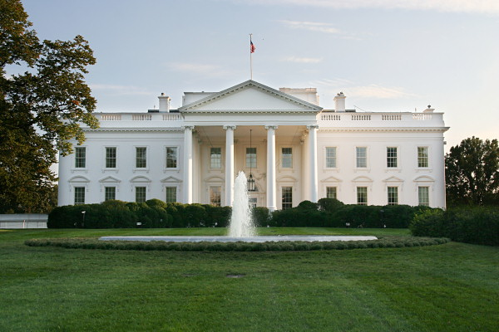
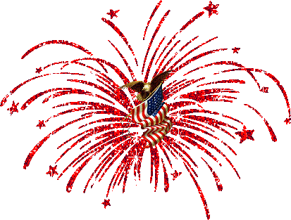
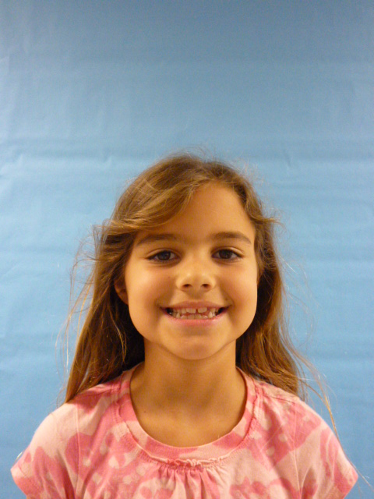
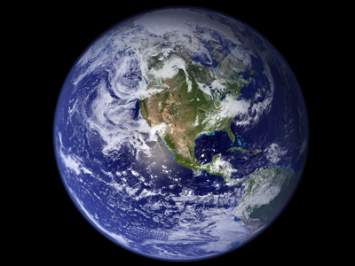
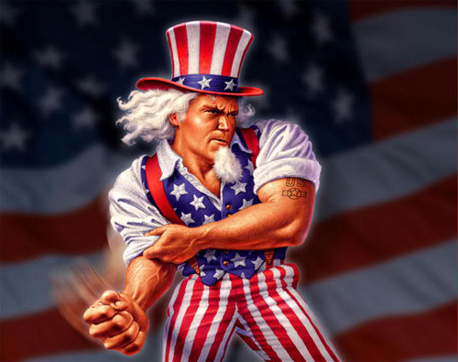
I love the u.s.a.!!!
Ill be a great president to you!
U.S.A.

Slide 2
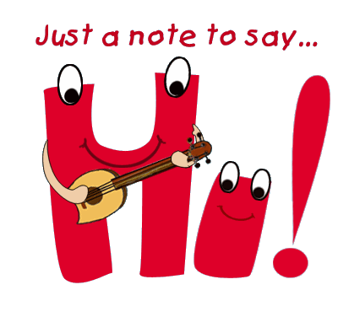
Hello I am the president since I am the president I would lower tax bills because some people need to afford tax bills and the taxes are too much to afford. It would be nice to lower gas prices too so I would try to lower prices and I would convenes people to lower the prices by making a speech.

Slide 3
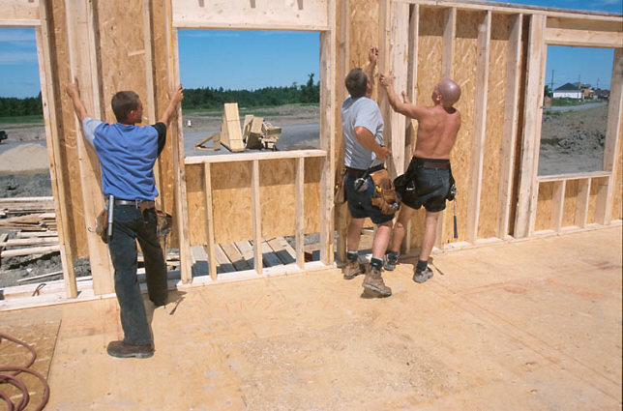
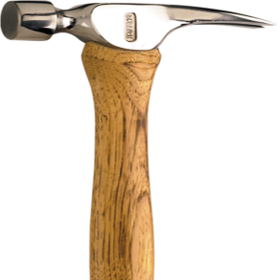
I would also build houses for people and I would get help so I could build the houses faster, if you’re asking how will I get help? Well I will make a speech to people and say I need help building houses and I need some volunteers. I know it will cost lots of money but if we build more houses it will be good for people who need help finding houses, and when we are done building houses you will feel proud of yourself. I would also ride in a limo, and throw money out of it so people could get free money.

Slide 4
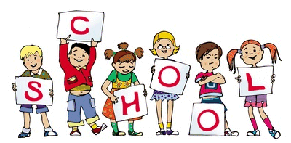
It would be lots of fun since I am president and I think you would like me since I am president. I know lots of people would want less homework but that is not the best idea, because you need to become smart and you need to get good grades.

Slide 5
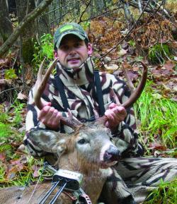
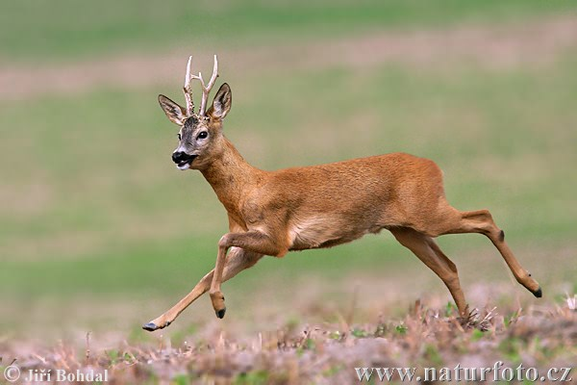
I would make sure hunters don’t hurt animals that are about to be extinct, but to do that I would have to make lots and lots of speeches it would be hard because people like to hunt rare and tasty animals to eat. Just one more thing I want to say that is… I hope everyone just is happy for me to be their president, and that you follow my rules, also that I want everyone to have a great four years it will be great fun doing this with you I really just want the people of the united states of America to finally decide that they have a great president like me! It’s really an honor being your grateful president but I just hope you are happy with me even if I’m not

Slide 6
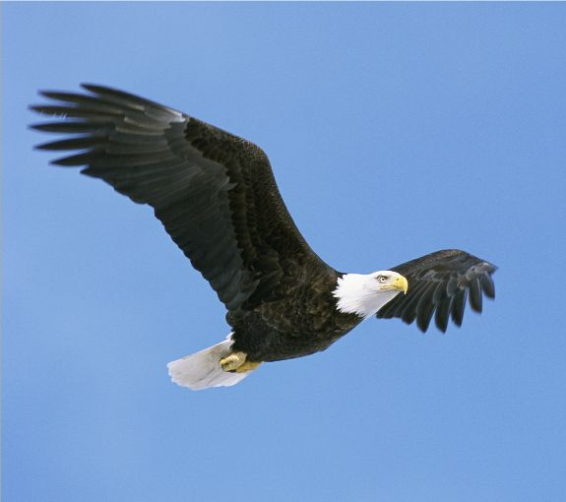
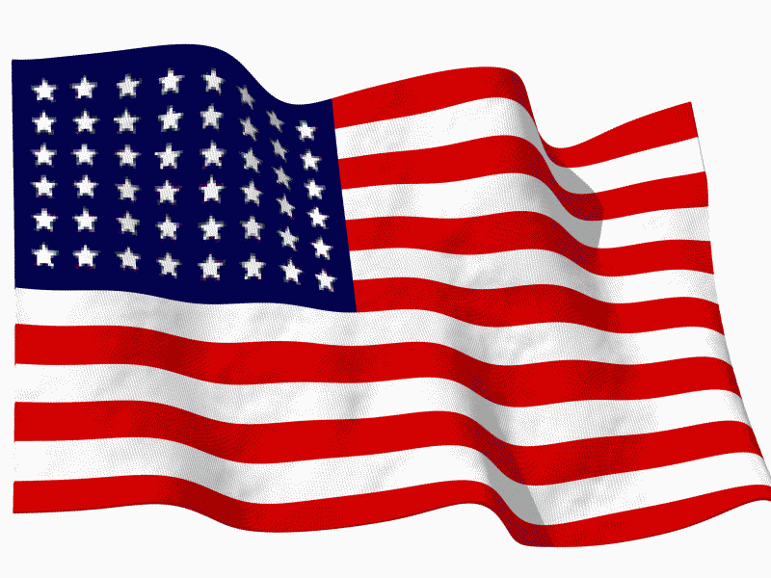
the one you voted for I think you’ll be happy with what you see but it will take time. But last but not least what I wanted to say is let me tell you some stuff about me, well there’s not much to say but my favorite colors are red and blue also I have a dog my dog loves the white house any way some more stuff about me I really like French toast sticks. But right now I can’t talk about me but I am done talking but this is from, Your president

