Slide 1
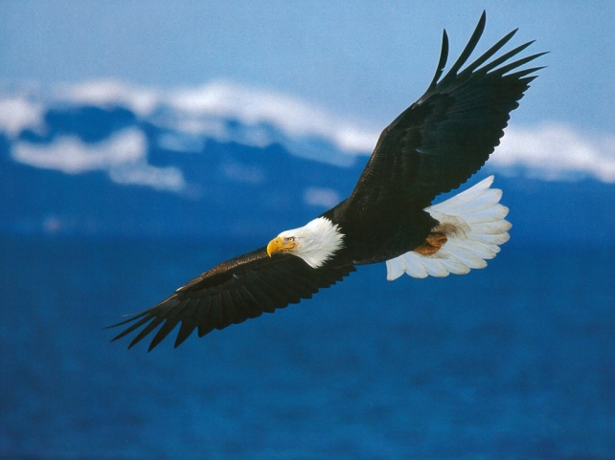
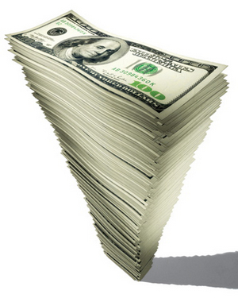
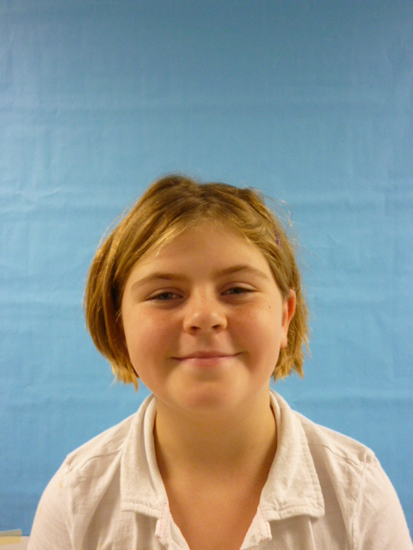
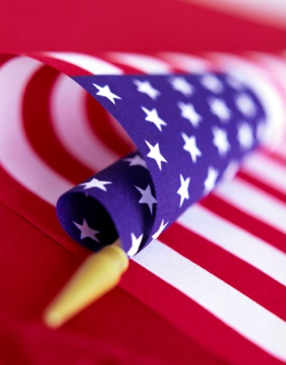
Mrs. President!!!

Slide 2
Thank you for electing me as your president. As your president
gas prices are to high hun. Well as your president I will cut the gas prices to $0.00 so if you need fuel you will have to pay nothing because it’s FREE!!!!!!!!

Slide 3
So kids all over the world are telling me they are not getting
Enough recess teachers and I will NOT approve that at all!!!

Slide 4
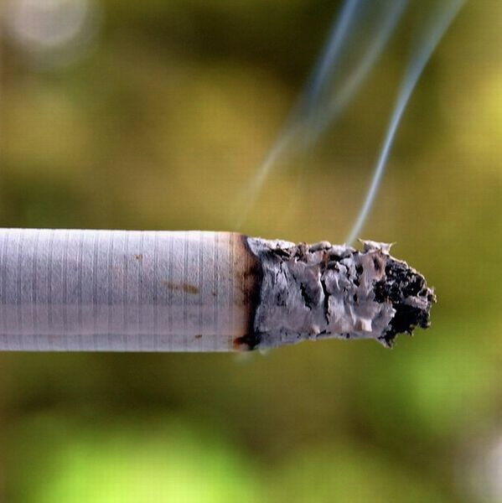
Also I order you NOT to smoke. You know why? BECAUSE!!!
If you smoke to much you will get CANSER!!!and that’s bad.

Slide 5
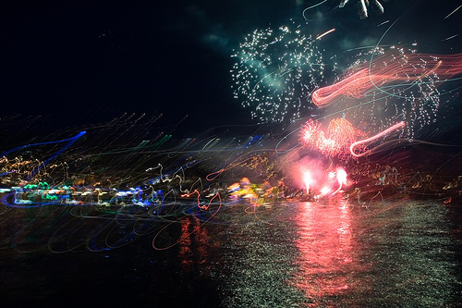
Ok ok my dad would kill those zombies puny little shaking
money maker. will fix this one. Like if we had a…ZOMBIE I
INVATION.My dad

Slide 6
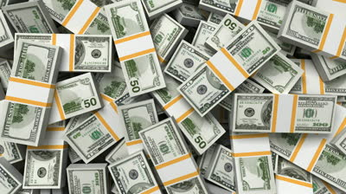
So if you like me for president I will give you a lollypop!!!!
I promise you I will be the best president I can be.
Oh! I forgot about the poor. You will have 1,000,000,000,000
$.You will be lucky duckys.Well bye!!!

