Slide 1
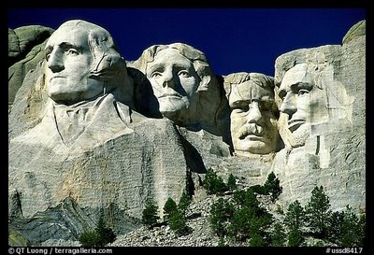
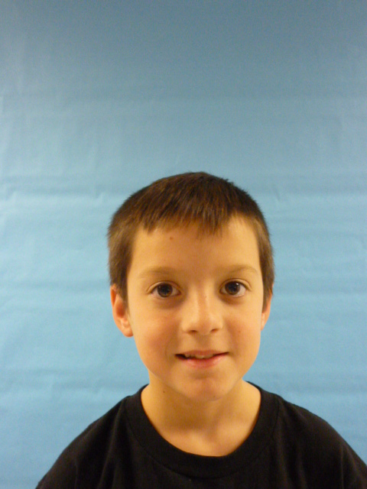
I'm your President. I will do what I say

Slide 2
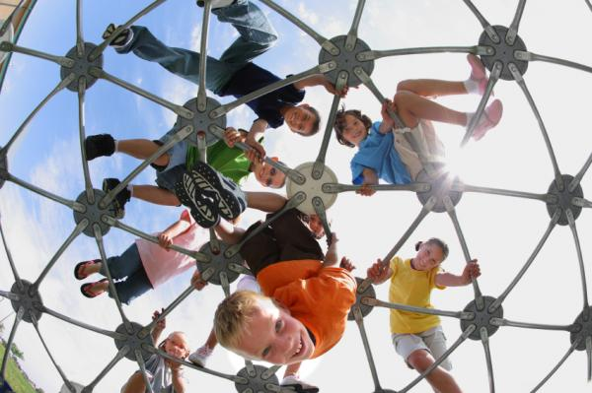
Hello its you’re president the first problem I think we need more recess. I really think so. We need it!! A lot! I like recess a lot.

Slide 3
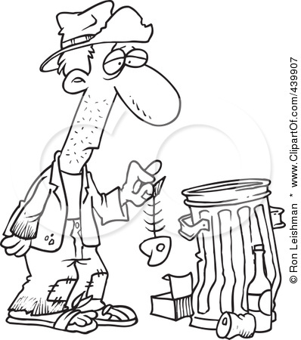
I would help the homeless because they need food to survive. Who would think they don’t need a home. They would be crazy. I do not know who would not want to give homeless people a home. I would build a free apartment for them only for them.

Slide 4
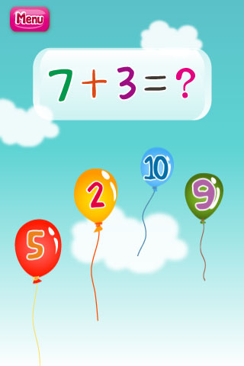
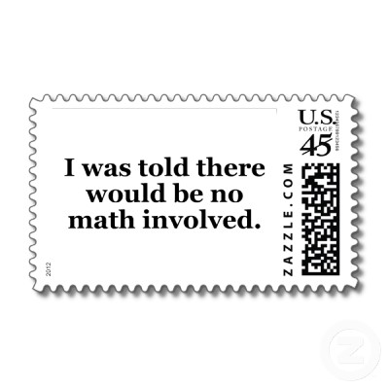
My second problem is No MATH!!!!!!!!!!!!!!!!! I do not like it!!!!!!!!!!!! No talking about math.

Slide 5
I will make school less homework because I do not like homework. I will make the whole United States of America without any homework. Again no homework Have more pajama days!!!!!!!!

