Slide 1
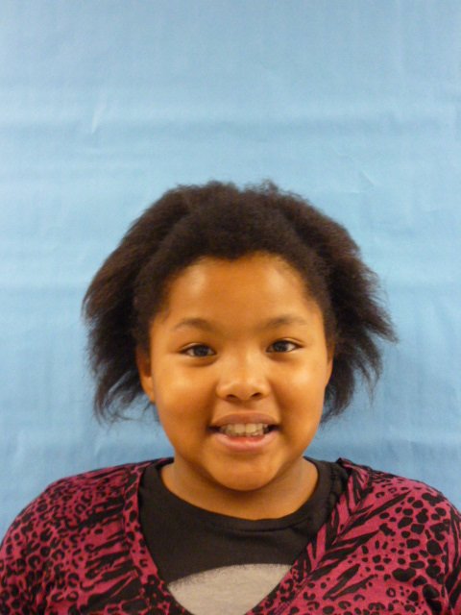
THIS
PRESIDENT

Slide 2
Hello I’m your newest President. I hope I will feel welcome to the White house. And welcome to this country

Slide 3
Now, the first thing I want to say is when teachers give you homework it takes a long time to work. And if you are in sports and you need to practice for your game. It’s not good too not practice for a play or game that’s coming up.

Slide 4
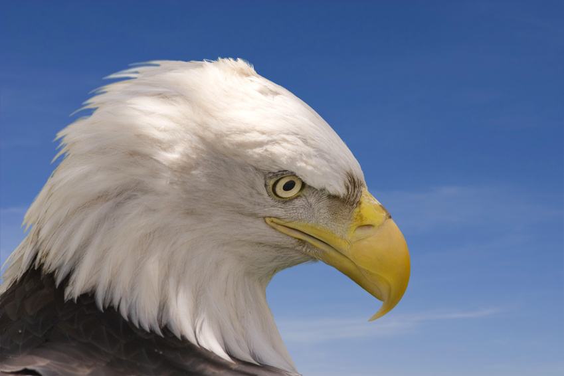
Next thing I want to talk about is littering. Everyone knows that littering is bad for the earth. But people think about themselves.

Slide 5
The last thing I’ll talk about is smoking. Smoking can do bad things to your body. Smoking can damage your lunges. It gives bad air into your body. I strongly disagree with smoking

Slide 6
'.
'.
That’s all I want to say!
Good day everyone.

