Slide 1
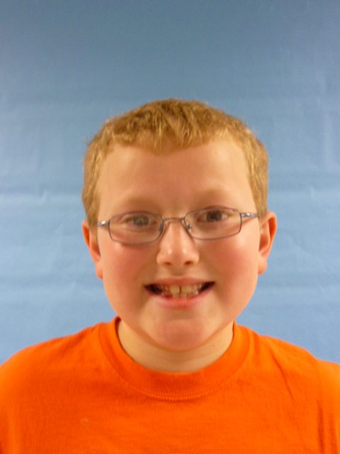
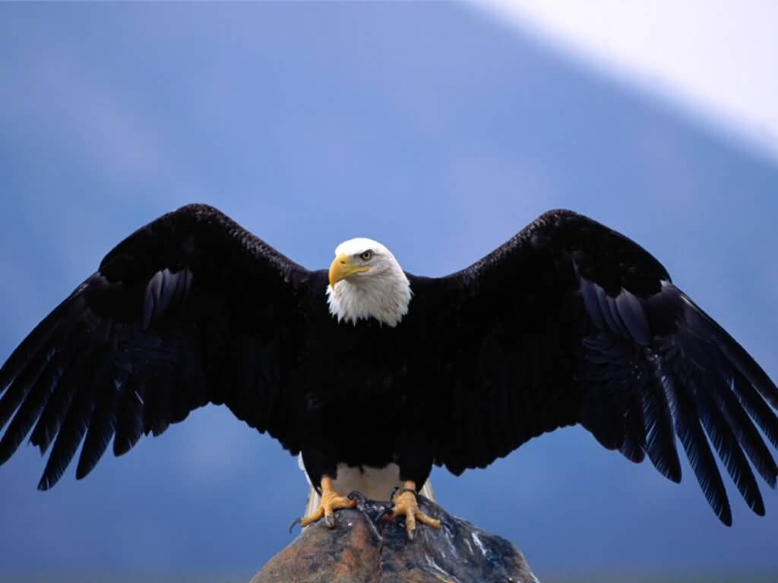
I am the PRESIDENT!!
USA

Slide 2
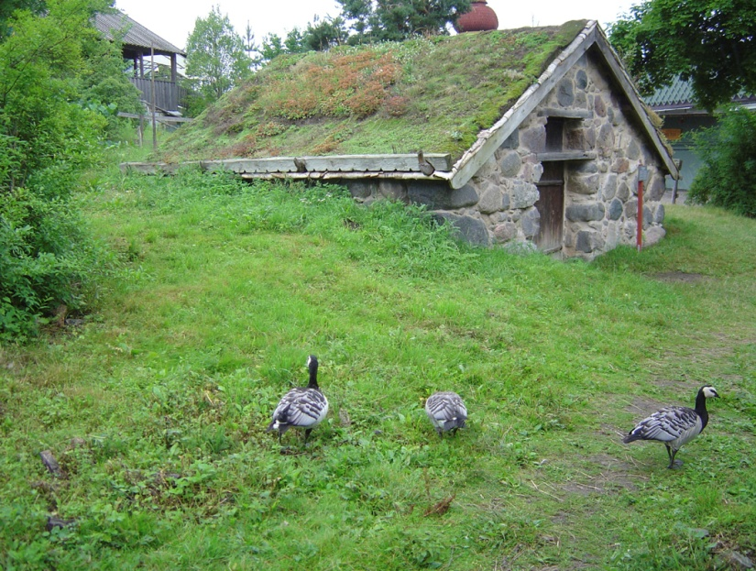
HI I AM THE PRESIDENT and I like to give food to the homeless and invite a homeless person to live in my house until we buy that homeless a nice house to live in. I will be kind to everybody a lot. I will enforce the laws of the United States. I will lower gas prices to make everybody happy.

Slide 3
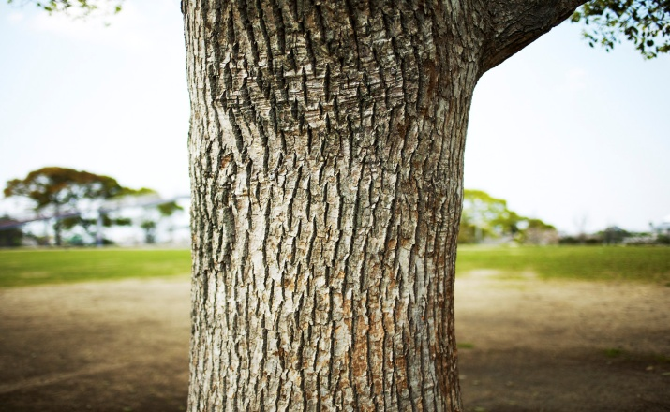
I will put up signs to tell people to stop chopping down trees. I will make the United States clean. I will make less candy cause candy is fattening.

Slide 4
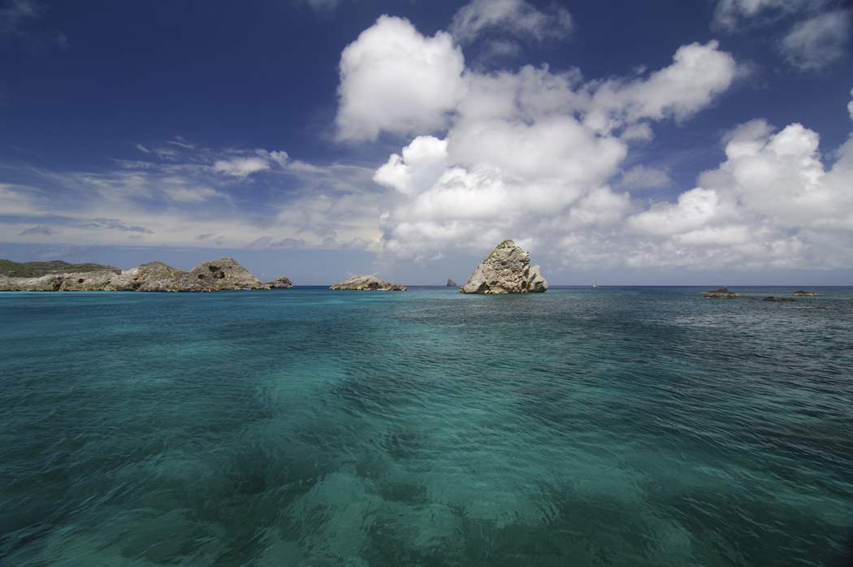
I will put up signs to tell people to stop littering on the oceans cause people liter a lot. I will tell all of the fast food places to stop selling fast food to everybody that walk’s in or use’s the drive threw. I will protect the schools with electric fences.

Slide 5
I will make a all reses day at all the schools. I will make a everybody day. I will make a field day at the middle of the school year.

