Slide 1
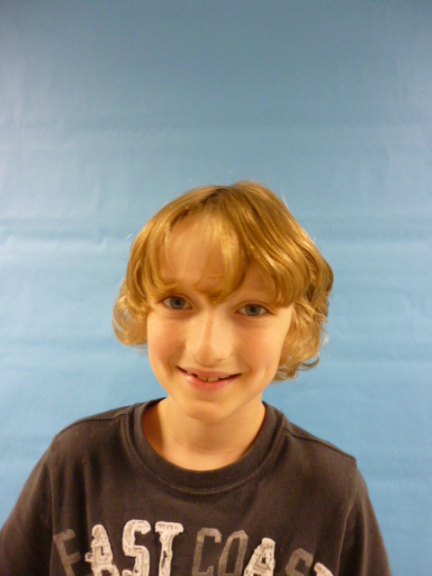

I like being the presidant

Slide 2
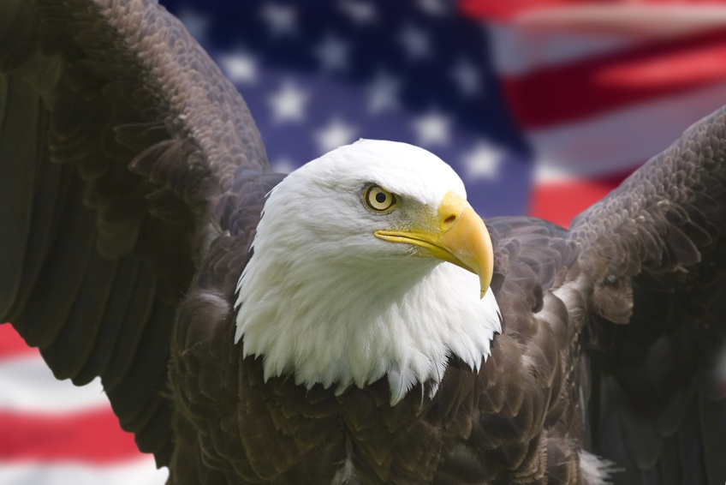

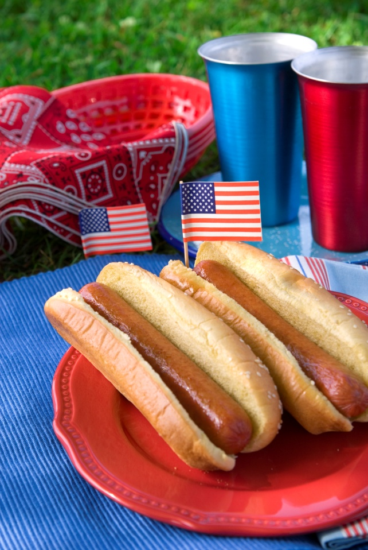
I’m President of the United State’s because I like to help people.

Slide 3
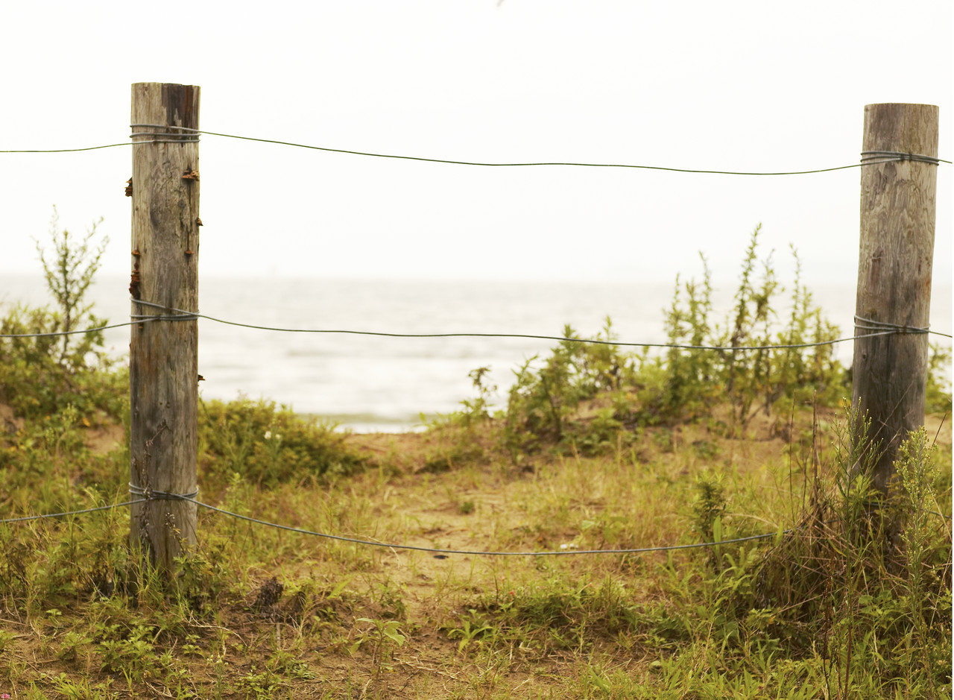

I would keep Wilder safe.With electric Fences

Slide 4
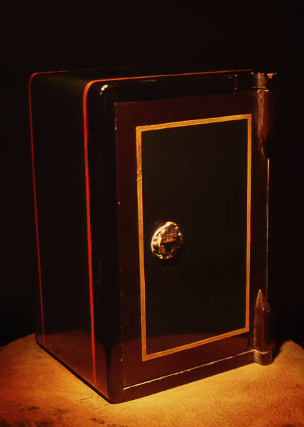
I would also keep money of the country safe. With a huge safe

Slide 5


I would stop robbery with guards everywhere well now my four years are over good bye!

