Slide 1
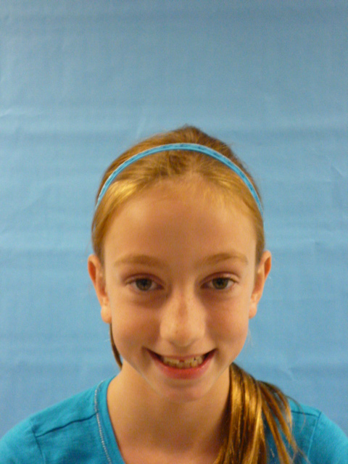
I'm the President of United States of America

Slide 2
I am thankful to be President of united states of America I’m glad. I will make a safe place.

Slide 3
I would make the recess longer by at least 1 hour hopefully you guys will like It i did it because usually it is 20 minutes.

Slide 4
I will make homework only 3papers a week so you guys can do more stuff like play and go some wear you just have to turn it in.

Slide 5
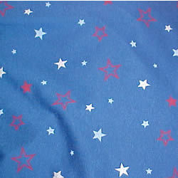
I will make hand writing at least 10 minutes because we all need hand writing to help us write like when you get older you have to sigh stuff.

Slide 6
I will give all of the people peace so you guys don’t have yelling screaming so you can have peace.

Slide 7
I will make no trash any wear so it can be a good country and world

Slide 8
SO I HOPE YOU LIKE MY SPEECH SO THANK YOU!..

