Slide 1
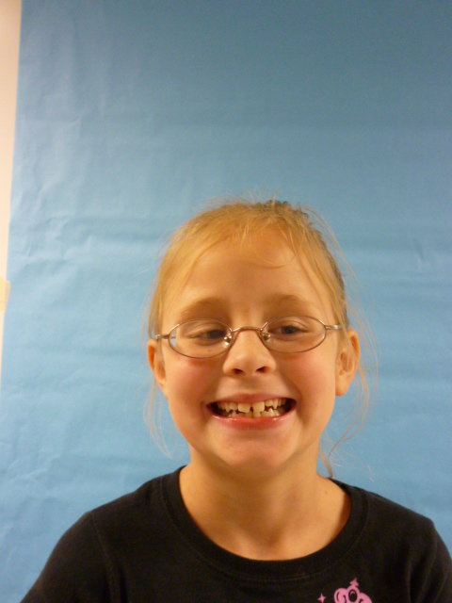
MISS PRESIDENT
USA

Slide 2
I am the President! I am here to help our country. I will do a lot of things to help you. I am a nice person. I tell the truth. I have always wanted to live in the White House. I hope you like me as your President.

Slide 3
I will make pets cheaper. Anyone who volunteers at a pet store can get a discount on a pet. If you pick up dog poop on the street you will get free pet food.

Slide 4
I will let kids have more recesses so they have more breaks. I will make the days a bit longer so we can have the recesses. Outside time is important.

Slide 5
I will make sure all kids in school have food. I will require all schools to have a school garden and have the kids pick all the fruits and vegetables from the garden so they can eat them.

Slide 6
I hope you like all these things that I will do for you. I think this will help everyone. I want everyone to be happy. I am the President!

