Slide 1
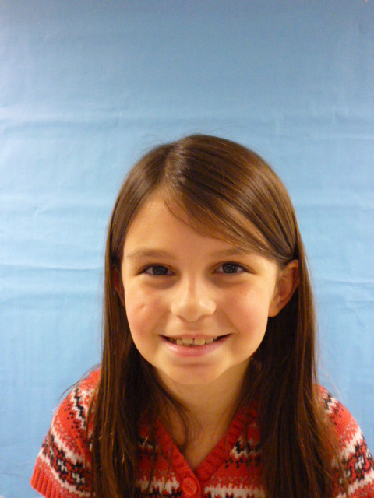
Mrs. President

Slide 2
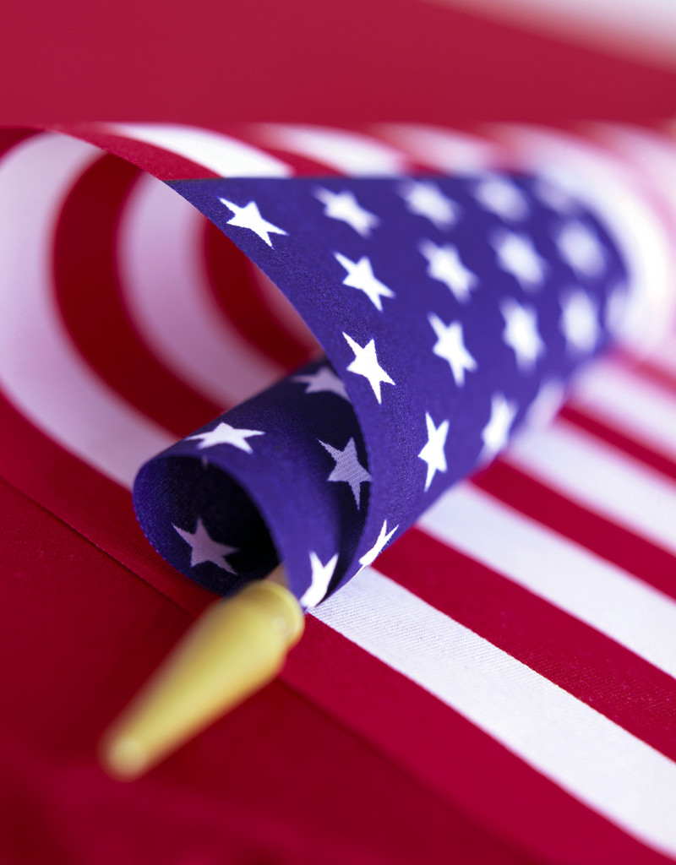
Hello I am going to tell you what I would do if I were President. I would be a great President for all the United States of America. I hope you like me as President.

Slide 3
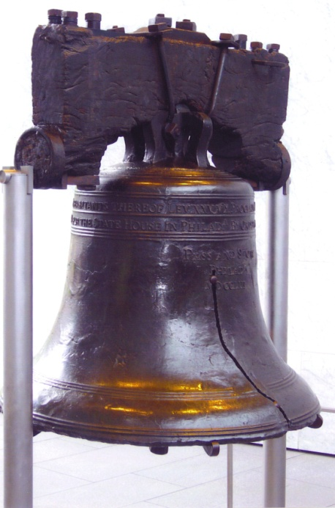
I would lower taxes and gas prices. I would lower money like it used to be. I would give homeless people some money. I would be a great President with money.

Slide 4
I would help stray animal’s find homes with nice people. I would help animals at the animal shelter get homes to. Animals that have a mean owner I would find them a better home.

Slide 5
People with no homes I would find them a home. I would by giving people with no hair I would give them some of my hair. I would help people with Cancer.

Slide 6
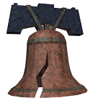
That’s all I have if I were President. Bye I hope you listened to what I had to say!

