Slide 1


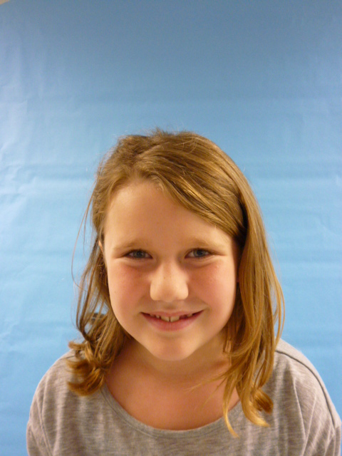

Hi!! I’m the president!!!t
USA!!!!!!!!!!!!!

Slide 2

Hi I’m the president of the U.S.A.!! Now I’ll tell you about ME!I am very responsible and kind, smart and I love to sing and I’m fun and if you do not obey the laws I might let you off the hook .Maybe!

Slide 3



I will try to be the be the best president ever .This is what I will do make all gas prices lower. How I would do it is use wealthy people’s money. Because I thank pore people could use it. And I would make all the wealthy people work more than pore people. Because I just don’t think there should be people that live on the street. But that’s not not me

Slide 4
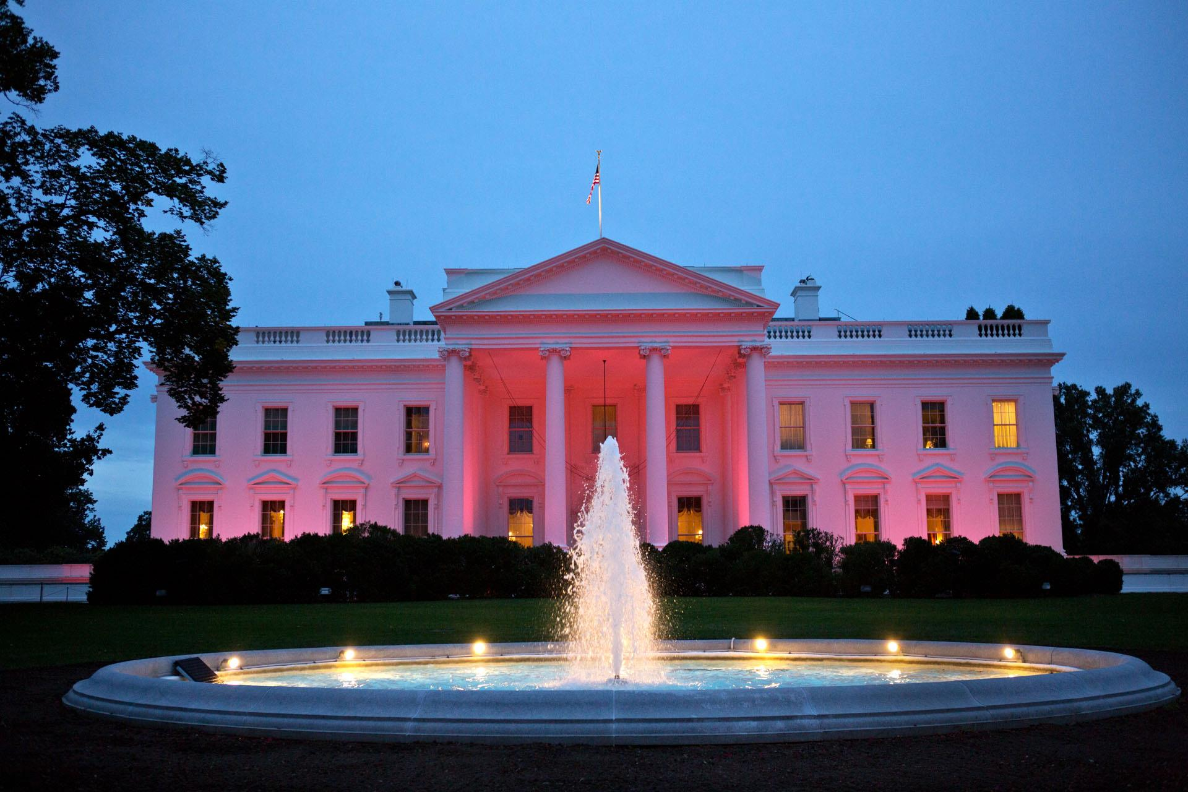
Now this is me. I would make every kid in wilder elementary get a lot of money every day!!That will be awesome!!And I’m going to re do the white house and it would be called the PINK house!!And all the furnisher would be made out of gummy bears. So when I’m hungry for a snack I could just take a bite out of my bed or chair.

Slide 5



And just for the Animals like: Lizards, crocodiles, snakes, and toucans. I will find homes for them even if there from the wild or zoos. And have a lot of food to live.

Slide 6

And that’s what I will do and I will try to be the best President EVER!!!!!!

