Slide 1
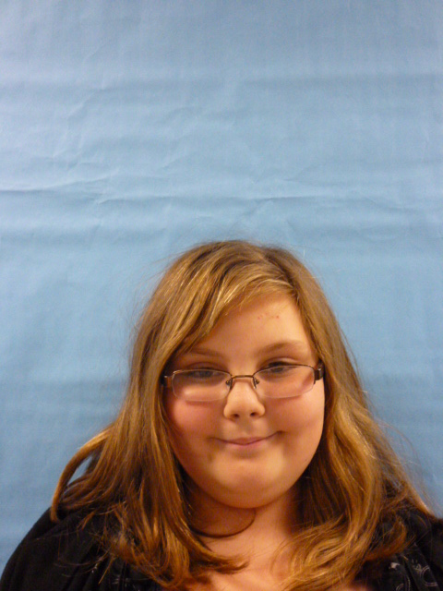
u.s.a

Slide 2
I demand people to get there drivers license when there 18.
I don’t want people to skip school on weekdays only if they are
Sick.
I want more kids to go to school so they can get smart.

Slide 3
I want kids to wake up at 6:00 so they can be at school on time.
I want for more people to have shelter.
I wan everybody to work there best as they can.

Slide 4
Kids under 14 should not be watching adult movies.
I want people to get in collage when you are 20years old.
I want people to be quite will testing.

Slide 5
I am glad to be your president.

