Slide 1

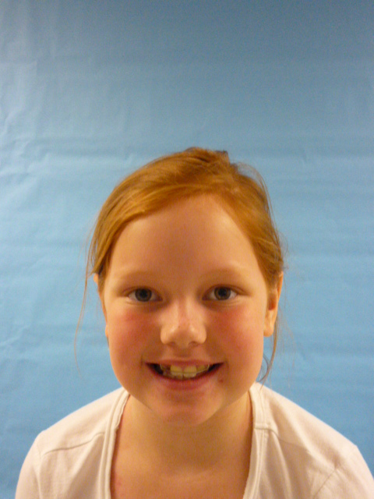



Slide 2

Things about me
Hello this is the President speaking and I will tell you some things. I love to read. I love horses I even have one. I also have a dog, two genie pigs and two fish. And I think that we need to…

Slide 3
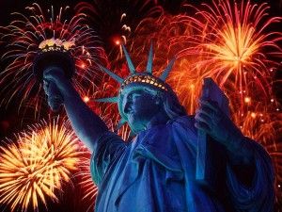

Taxes
Lower taxes. It is a well known fact that they are too high. It’s true. No I’m not joking. They are too high. Really. That is the truth.

Slide 4
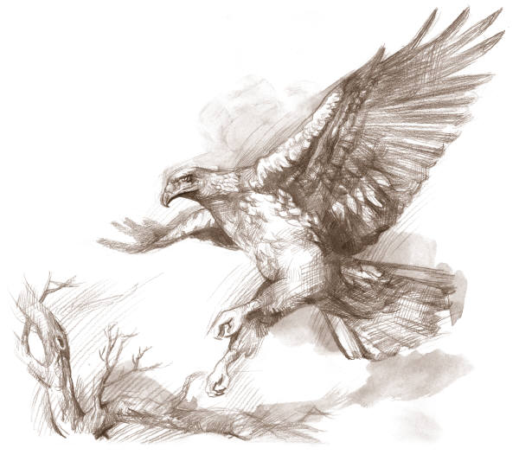
Fun times
And I am all about fun so I will make sure we have LOTS of Fun in my four years. AND NO BAD PEPOLE! Do not get carried away! I know how it feels. I have done it to.

Slide 5
Fun days
And of Course we will have national FUN DAYS! And I would also remodel the Wight house. (I would paint it blue.)It would look cool.

Slide 6
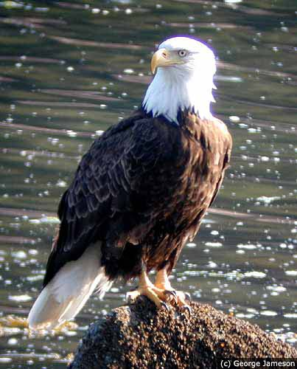
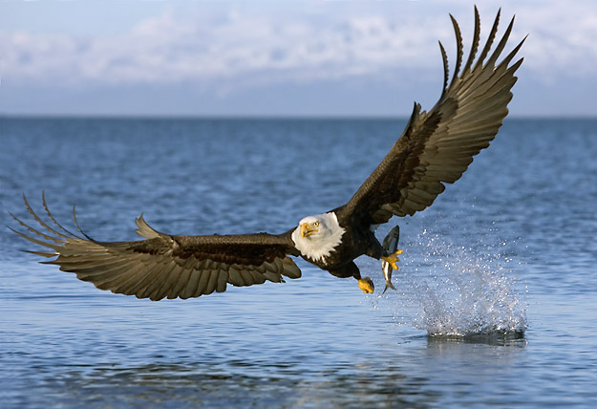

closing
Now I have to say goodbye but that’s what I’m going to do as President signing off the
President.

