Slide 1
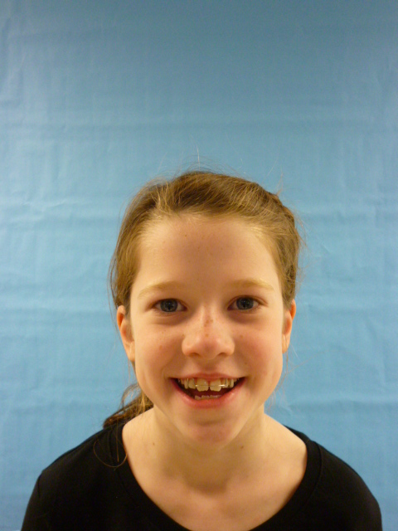
Mrs. President

Slide 2
I am thankful to be the United States president. I will lower gas prices, make schools have longer and more recesses and shorter school years.

Slide 3
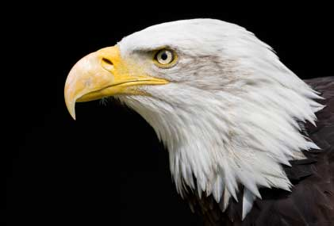
I would STOP TAXES! I am honest, respectful, quiet and nice. That’s why I would be a fantastic #1 President!

Slide 4
People NEED to stop trashing our oceans and start to recycle A LOT MORE!!!!! Sea gulls beaks are getting stuff on their beaks and dying .

Slide 5
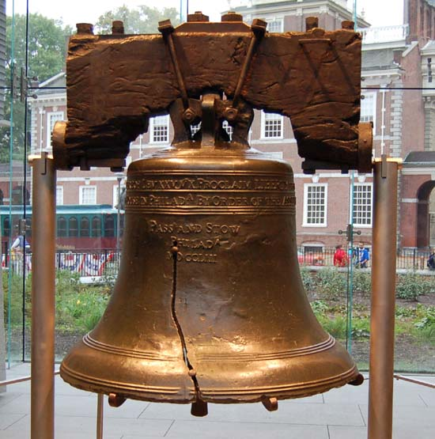
I would try to stop all of the wars. I would stop all war because people are dying.

Slide 6
Bye, that’s all I have to say! Please elect me again next year!

