Slide 1
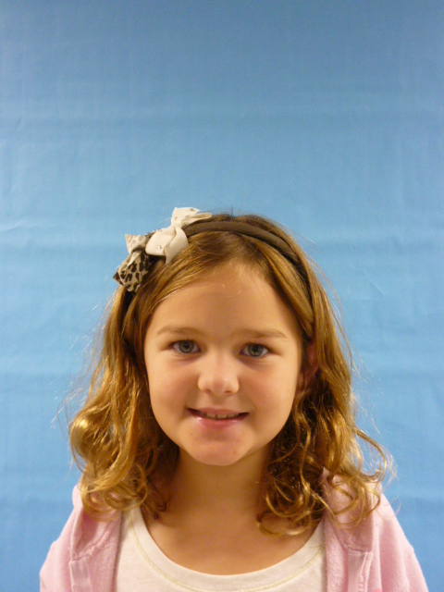
I am glad to be President

Slide 2
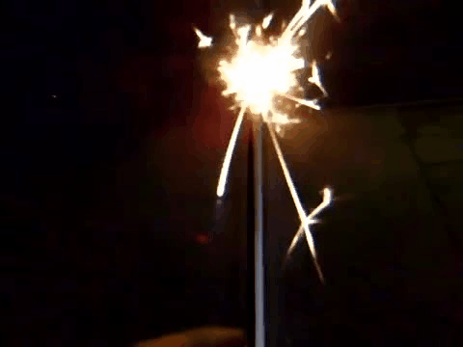
I am thankful to be the President of the United States of America I would give more toys to play with and games to play outside.

Slide 3
I would give people more candy especially chocolate candy
I would give more school on Saturdays Sundays.

Slide 4
I would also have no math at all or home work also spelling.

Slide 5
I would give less recess and more specials like computers
I am glad to be president.

