Slide 1
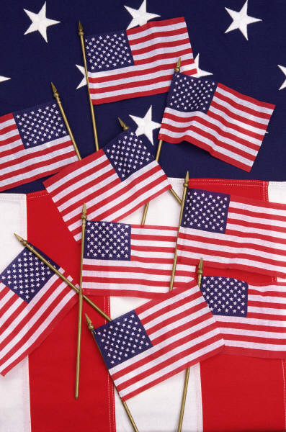
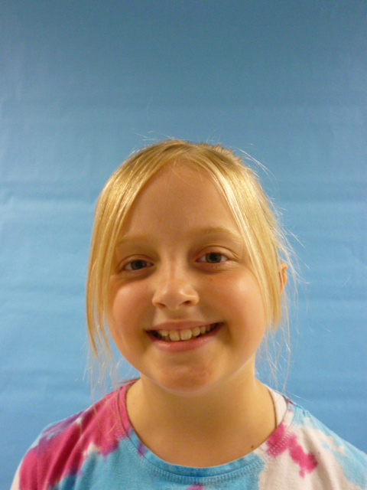

Slide 2


I am Your PRESIDENT!!!!!! Here are some things you should know about me. I’m funny. I’m nice. I’m trustworthy. I’m responsible. And I make necessary rules.

Slide 3


Since I am President I would like to make sure that everyone followed all of the rules but I wouldn’t make unnecessary rules. Like these unnecessary rules… “If your pencil is shorter than 4 inches you will be thrown in jail!” or “if you wear miss matched socks you have to pay more taxes.”

Slide 4
Another thing I will do is let kids have more recess by making a few national holidays like…”All Day Recess Day” or “Kids Day” when the kids get to do anything they want.

Slide 5

Here is another. I would make a rule that smoking is against the rules because it can rot out your lungs! My great grandpa is 80 years old and he smoked for 20 years. He had to go to the hospital because his heart wasn’t working right. He survived but he has trouble breathing.

Slide 6

I hope you think these rules are necessary! I love these United States. And I am your President!!!!!!!!!!!!!!!

