Slide 1
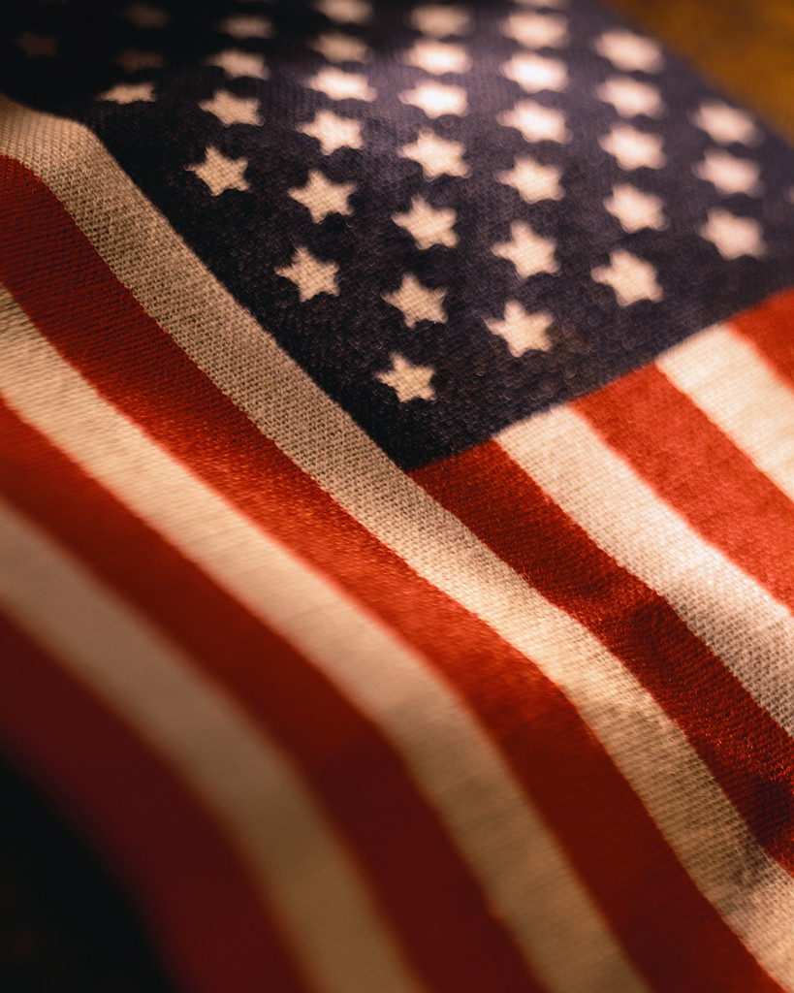
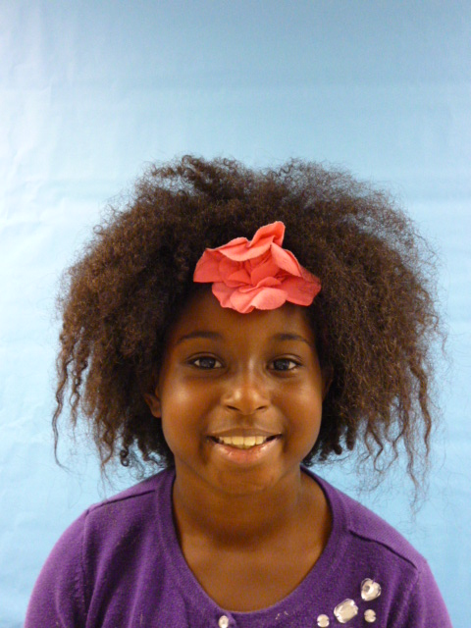
[[[
Hello I'm your new President
1

Slide 2
Hello I’m your new President and here is a couple things you should know about me I am a good leader and I will help the world.

Slide 3
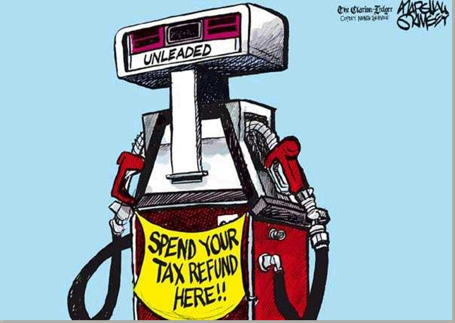
Because I’m President of the United States I would make gas prices lower because some people don’t have enough money to pay for it.

Slide 4
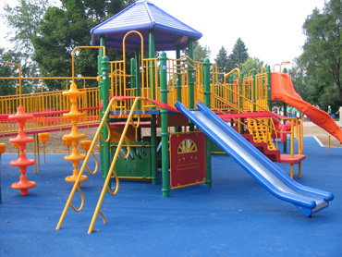
I would also make WILDER Elementary School have longer recess and more school holidays.

Slide 5
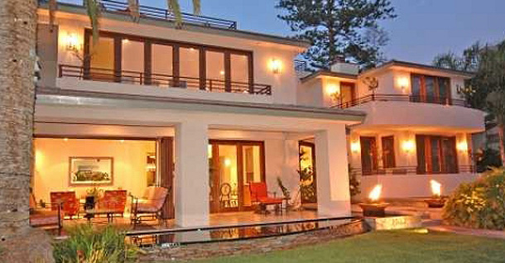
And it would be nice for at least every body in the world to have a house.

Slide 6
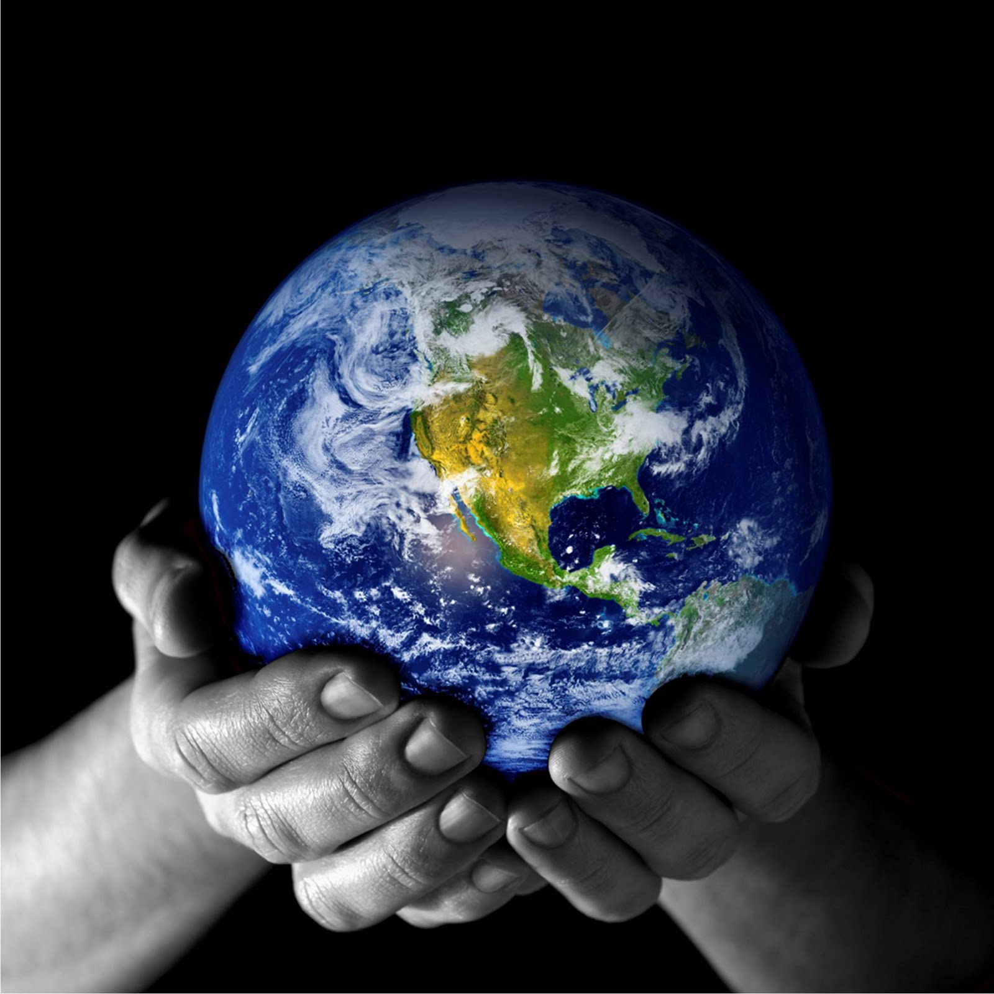
And last but not least I would keep our world safe The, President

