Slide 1
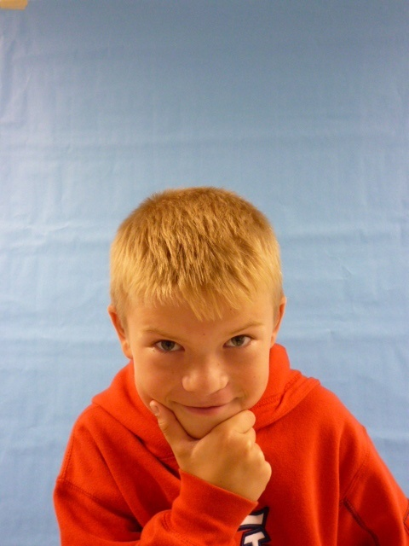
Mr.President

Slide 2
Thank you thank you ok I need to tell you something ok don’t you think that the gas prices are too high. Again Somebody is taking from china and what money approve that. I think that we should band drugs.

Slide 3
Ok I have another thing to say some school’s kid’s have to wake up at 6:00 to get to school on time. They have to get to school at 6:30 they don’t have time to get there breakfast eaten, get dressed and brush their teeth. That’s why I think we shod make the time for them to wake up at7:30 and go to school at 8:00

Slide 4
Another thing all people shod have a home’s. About how many people have brooked it to a house we can stop that if we have alarm system .arose cars.
.

Slide 5
I’m glad I’m your president

