Slide 1
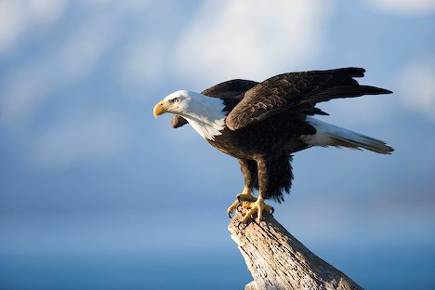
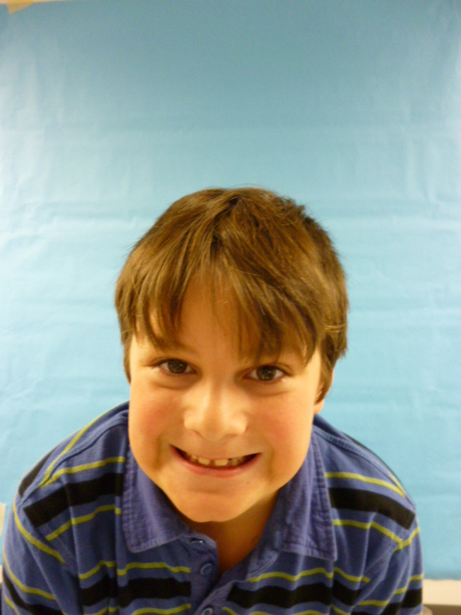

Slide 2
Hello, I am the President...I think I will make a good leader.

Slide 3
I will stop the war because many people are dying. I will stop it by not sending men out in battle with other people.

Slide 4
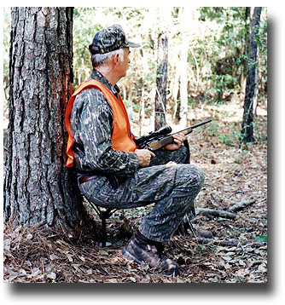
I will make new laws, like banning alcohol. Also I will make our economy a better place by having hunters eliminated.

Slide 5
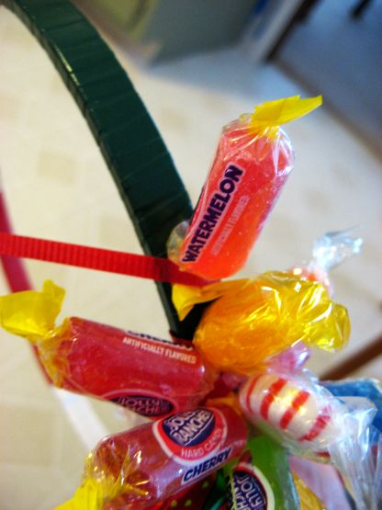
The schools should have more candy, because it would give kids more energy to play outside. Also kids will have not to pay for lunch. I will make recess longer for kids because they will get more time to be active, I will tell school districts to make recess longer.

