Slide 1
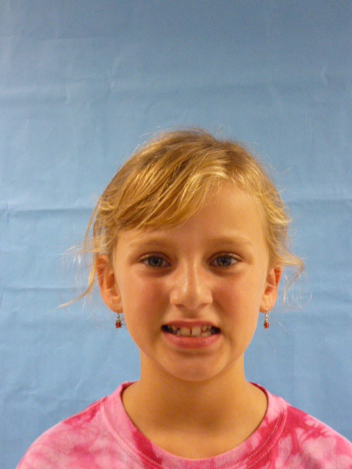
I am Miss President
USA!!

Slide 2
Hello world! I’m so excited to be your United States president! I will have a lot of plans for the next 4 years. I wish I could be it for 49 years! I am so glad to be president. I would make this a better place. I would like to say thank you for being elected president. happy 4 years!

Slide 3
NOW LETS talk about smoking, Smoking is a really bad habit. I would not encourage people to smoke. It makes your lungs turn black. Plus you will die! I know that people get really close to smoking. Cigars smell bad and are gross!

Slide 4
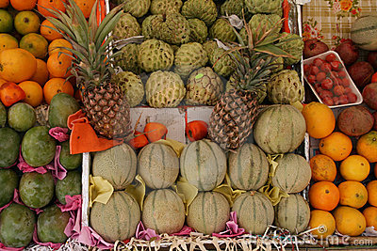
Health is so important!!!! We need fruits and vegetable markets. We at least need 5 markets people drink to much pop. We all need to be active and have everyone In the WORLD! the UNIVERSE! drink water or milk. Pop makes your teeth rot and make them fall out and you can have DENCHERS! and trust me no one wants DENCHERS!!!!!!!!!

Slide 5
Now lets see oh yes, and no one I mean NO ONE should ever take medicine from people that drink beer or smoke. it is a bad idea! Now don’t you DARE think about taking beer
It makes you act weird!
it might not taste good my opinion is: YUCK!!!

Slide 6
I’m so happy, so if you need anything just call and I will be sure to answer it just MAYBE!! Have fun and enjoy the evening happy day and good bye! I’m so glad to be here!!!!!!

