Slide 1
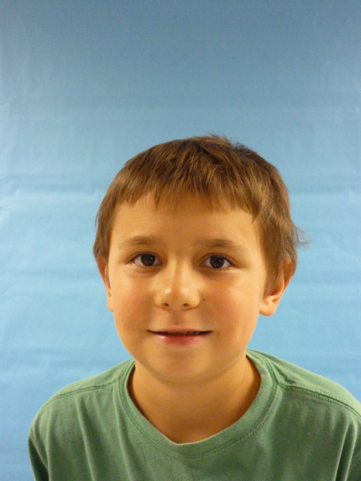

Slide 2
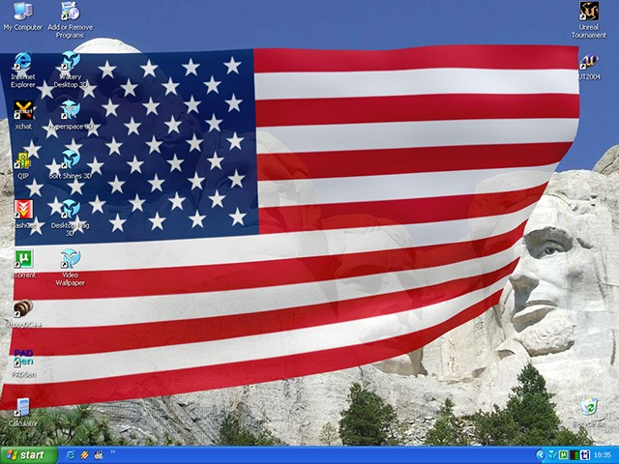
What I will do when I am President, I’d make safer places, and I’d make more recess, I would make a better life.

Slide 3
I would make a national everybody day, and help people, I would like to live in the white house. I will stay on time, And I Will try to make life better, I wont Make rules like you have to be rich or you to jail.

Slide 4
Or you have to never make a single mistake, if you’re in a you have to hold your breath, I’ll make it safe, if it`s not safe I won’t allow it,

Slide 5
I will care for my country; I will stand above the rest, I will make you proud, I can do it.

Slide 6
You’ll won`t me, I hope you like this, I worked very hard, you’ll like me.

