Slide 1
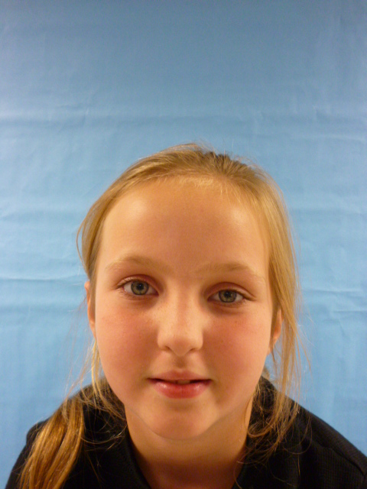
Mrs presdant …..

Slide 2
I am thankfull that you eleted me for presedent of the united states of America.

Slide 3
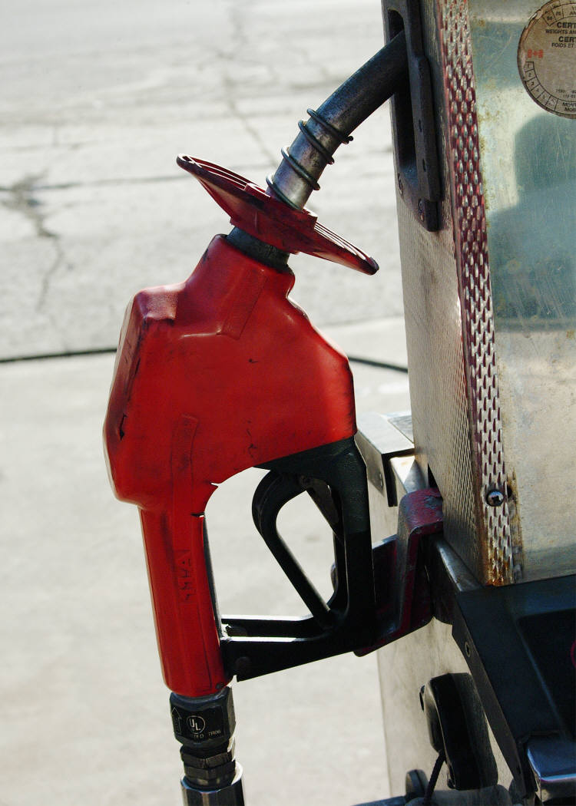
I will make gas prices lower

Slide 4
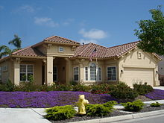
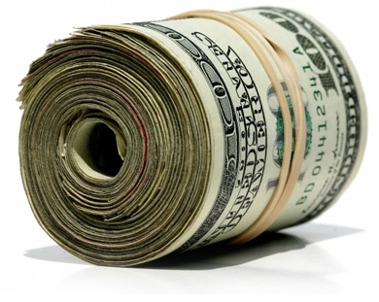
I will give homeless people money and a home.

Slide 5
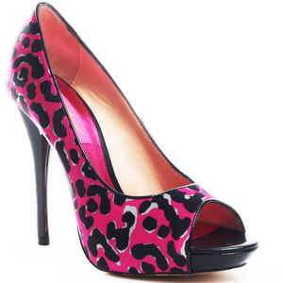
I will give people cloths and shoes.

Slide 6
That’s all I half to say bye

