Slide 1
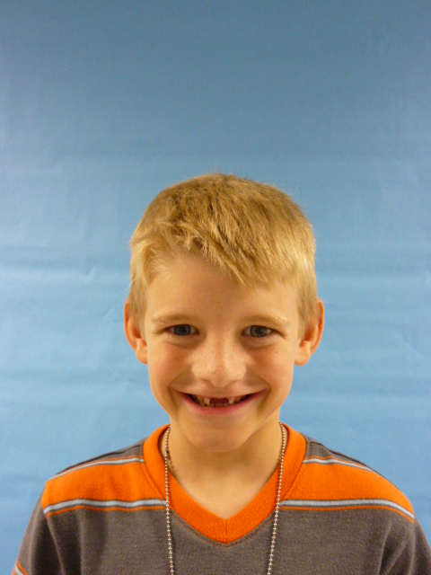
U.S.A.

Slide 2
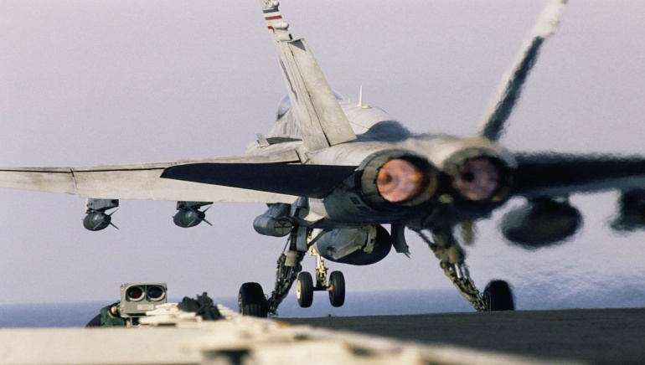
Because I am President I would give kids more recess at school. I would give kids more free time. I well keep the people safe.

Slide 3
I well make all the people follow the rolls. I will hire more cops. I will make school belle free.

Slide 4
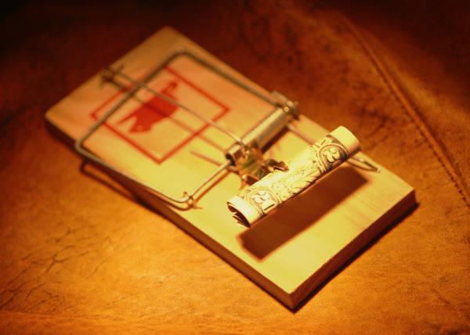
I will give kids more candy. I will give the Presidents more homes. I will make school harder .I will make the people fallow the rolls.

Slide 5
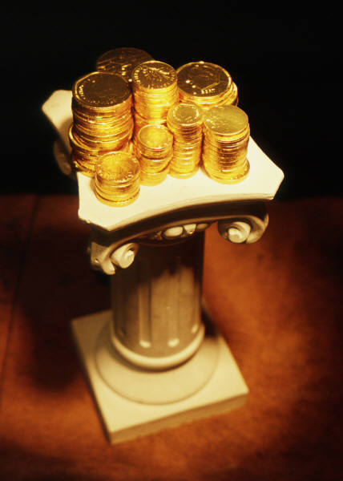
I will give to the poor. I will give house to poor people. I will make home work easier. I will make a flag for all of the stats.

Slide 6
I will give the army more tanks. I will make a new color. I will make a new websites. I will give kids more candy.

